Slide 1
Referral services
Module 11

Slide 2
Module 11: Learning Objectives
At the end of this session students should be able to demonstrate knowledge of:
The diverse needs of women and children experiencing violence
Social services and other sources of help in the community
How to build a relationship with referral services and strengthen the referral network
Notes:
At the end of this session students should be able to demonstrate knowledge of:
The diverse needs of women and children experiencing violence
Social services and other sources of help in the community
How to build a relationship with referral services and strengthen the referral network

Slide 3
Review Hahu Relasaun di’ak
Notes:
Ask the students ‘can anyone tell me the steps in Hahu Relasaun?’ Compliment the student who recalls it.
These are the elements of good practice when responding to victims of violence
Today we are learning about how we can continue support for women through referral services in the community.
Next module we will be visiting some of those services and learning how to do a good referral.

Slide 4
What kind of help might women need?
Women may have many needs in addition to health care
Need to know about resources and how to refer
May be useful for other vulnerable women (disability, abandoned, mental health problems)
Support services are available to help www.hamahon.tl
Notes:
Women who experience violence may have many needs in addition to health care
Can you tell me what other kinds of services women who experience violence might need?
It is important for health providers to know about available resources and services and know how to refer women to get the help they need:
Police – VPU, Community police
Uma mahon
Fatin hakmatek
Legal aid
Financial help
Support groups
Counselling
Mental health care
Disability services
These services may be useful for other vulnerable women, such as those with a disability, mental health issues or who have been abandoned by their partner or family
See handout on referral services. This information with up to date phone numbers is available on the website www.hamahon.tl so please check it regularly for changes.

Slide 5
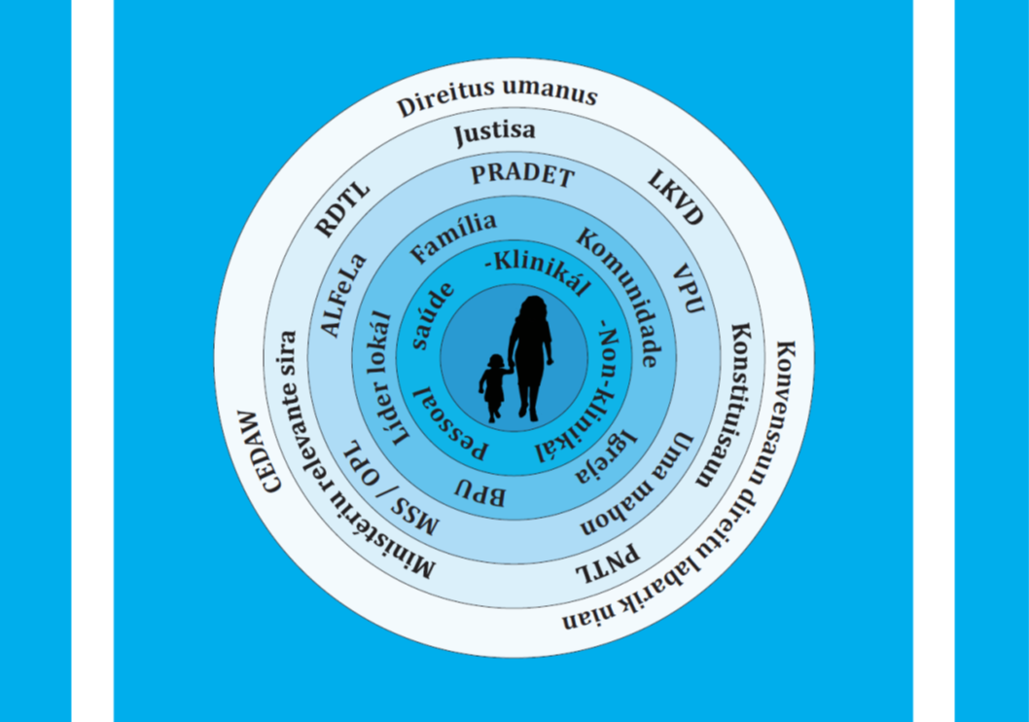
National system to help victims of violence
Government, laws
Police, justice
Safe houses, referral services
Health services, medical forensic
Community, local leaders, church
Notes:
There is a national system in Timor-Leste which supports victims of violence, from the national laws to police, safe houses, training for local leaders, and responsive health systems

Slide 6
Government
What is the governments’ role in addressing violence against women and children?
What is the role of each department?
MSSI (Ministry of Social Solidarity and Inclusion)
MSSI OPL (Child Protection Officers)
SEII (Secretary of State for Equality and Inclusion)
Ministry of Health
Ministry of Justice
Ministry of Education
Notes:
Ask students what they think the government’s role is in relation to violence against women and children?
TL Government has an obligation:
to provide assistance to victims
prosecute cases
prevent domestic violence
These international and national policies assist them to do this:
Signatory to CEDAW and Convention on the Rights of the Child (2002)
Law Against Domestic Violence (2010), Penal code on spouse and child abuse (2009)
Ask what they think the role of each department might be? Check that they cover the following:
MSSI (Ministry of Social Solidarity and Inclusion) – direct help to victims, food, money. Child and family welfare workers. Monthly meeting of service providers in every district to discuss complex cases, improve coordination of NGOs
MSSI OPL (Child Protection Officers) – Need to be informed of all child victims of violence (under 18yo). Works with Ministeriu Publiku when children need to be removed from family and placed in a refuge
SEII (Secretary of State for Equality and Inclusion) – coordination role, National Action Plan on Gender-based Violence.
Ministry of Health - responsible for providing medical assistance and follow-up for victims, preservation of evidence, report to police, public prosecutor and other competent authorities, refer to shelters and other services as warranted
Ministry of Justice – responsible for the courts and PCIC
Ministry of Education – responsible for helping women and children who have been the victims of domestic violence and stopped their schooling to be able to attend

Slide 7
Police
Must intervene in cases
Must prepare and submit evidence
Vulnerable Persons Unit – municipal level
Community Police – village level
Notes:
Must intervene in cases reported by the victim, another person, health services or other organisations
The police must prepare the criminal complaint and evidence and this needs to be submit to the public prosecutor within 5 days of being reported
VPU – vulnerable persons unit deals specifically with victims of violence and other vulnerable people, is only at the municipality level
Community Police - at the village level, can make referrals to the municipal level

Slide 8
Justice
ALFeLa
Public prosecutor
Public defender
Tribunal
JSMP
Notes:
ALFeLa – provide legal advice and assistance to women and children and advises on the progress of cases.
Public prosecutor – represents the people of Timor-Leste in the prosecution of crimes
Public defender – represents Timorese people accused of breaking the law
Tribunal – determines cases and decides about sentencing
JSMP – The judicial system monitoring program observes and reports on decisions made in court to improve the judicial and legislative systems in Timor-Leste

Slide 9
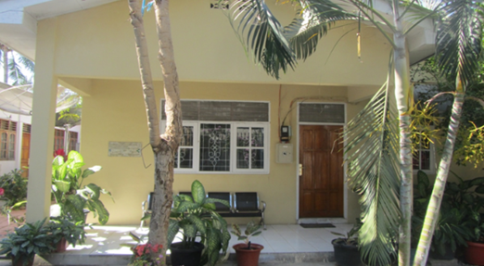
Fatin Hakmatek
For victims of domestic violence, sexual assault, child abuse, abandonment and human trafficking
Provides safety, care and treatment
Referral network across all districts
Photo: Fatin Hakmatek Dili
Notes:
If nobody did a presentation on Fatin Hakmatek you can ask if anyone has heard of these? Do they know what their role is?
The NGO PRADET runs Fatin Hakmatek, linked with referral hospitals in 5 districts
Fatin Hakmatek are for helping victims of domestic violence, sexual assault, child abuse, abandonment and human trafficking
Provides safety, care and treatment - Services include trauma counselling, medical treatment, medical forensic examination and documentation, maximum 3 days emergency accommodation, basic needs such as transport, food and clothes, referral to other relevant services, follow-up medical treatment and home visits.
Where are they located?
Within hospital grounds in:
Dili (covers Dili, Liquisa, Aileu, Manatutu, Ermera)
Baucau (covers Baucau, Lospalos, Viqueque)
Suai (covers Ainaro, Manufahi)
Maliana (covers Bobonaro)
Oekussi (covers Oekussi)
There are also trained doctors and midwives at the CSI in Lospalos, Viqueque, Ainaro and Manufahi that can help victims with medical-forensic examination, documentation and counselling

Slide 10
Refuges (Uma Mahon)
A secure place for women and children
Receives referrals
Provides accommodation and essential items
Examples of refuges for women and children in Timor-Leste
Notes:
Ask students if they have heard of an Uma Mahon?
A safe and secure place for women and children victims of violence to stay
Receives referrals from police VPU, health services and other organisations in the rede referral network
Provides accommodation (3 days to 3 months or longer), food, mediation, advocacy, connection with other services and reintegration into the community
Examples are Fokupers (Dili), Uma Pas (Baucau), Maria Tapo (Maliana), Uma Mahon Esperansa (Viqueque), Uma Mahon Luzerio (Lospalos), Uma Mahon Forum Peduli Wanita (Oecusse)
Refuges for young mothers and children – Casa Vida (Dili), Forum Comunicação e Juventude (FCJ), Uma Mahon Salele (Suai)

Slide 11
Disability services
People with a disability are more at risk of violence
May need help from other services
Many organisations are available to support people with different disabilities
See handout
Notes:
People with a disability are more at risk of violence
They may need help from additional services to meet their needs
There are many organisations that can work with the health sector to help people with different disabilities
Refer to the handout in this section. This poster is from the Ministry of Health funded by the Australian government through Partnership for Human Development (PHD). It shows the organisations that work in the area of disability.

Slide 12
Activity: Disability services
Group discussion:
Do you know anyone with a disability?
What challenges do they face in their daily lives?
Are they getting assistance from any services?
If yes, is the service listed on the handout?
If no, what services are on the handout that could help them?
Notes:
Purpose: To discuss the different needs of people with disabilities and know the services that can help
Time: 10 minutes discussion
Instructions:
Ask the students ‘do you know anyone with a disability?’
What challenges do they face in their daily lives?
Are they getting any assistance from services?
If yes, is the service listed on the handout (if it isn’t, write it down)
If no, what services are on the handout that could help them?
Summarise that it is our job as health providers to assist people with disabilities and connect them to support they need from other services in the community

Slide 13
Other Organisations
PRADET
Marie Stopes
Empreza diak
RHTO
Alola Foundation
FOKUPERS
Notes:
Can you tell me what types of services these other organisations provide?
PRADET – Psychosocial recovery and mental health counselling, socio-economic program for victims, conducts training (medical forensic examiners, recognising and responding to non-accidental injury, use and abuse of alcohol, healthy relationships, counter trafficking) as well as running Fatin Hakmatek in 5 districts
Marie Stopes - Counselling and treatment for sexually transmitted infections and family spacing
Empreza diak – women’s economic empowerment
RHTO – Helps people with disabilities
Alola Foundation – economic empowerment for women, care packets for newborns
FOKUPERS – domestic violence and women’s rights advocacy as well as safe house)
Can you think of any other services that can help victims of violence?

Slide 14
Non-formal Groups
Every place has different resources
Communities and extended family can help keep people safe
Additional help from good people:
Xefe suco
Xefe aldeia
Family
Lia na’in
Church (madre, padre)
Be aware of gender inequality and justice for victims
Notes:
Every place has different resources. When you go to a new placement find out what support is available for women and children in the area. This is especially important in rural areas.
People in the community and in extended families are important for keeping women and children safe and holding perpetrators accountable, abuse should never be hidden! – “the community can be the eyes and ears that keep women and children safe”
There may be additional help available from good people in the area
Xefe suco
Xefe aldeia
Lia na’in
Family
Church (madre, padre)
Can you think of any other people in the community who might be helpful?
The Law says that you cannot refer cases of domestic violence to community leaders to be resolved. But for some women, they can be a good source of additional support.
It is useful to discuss with women who the supportive people are close by and how they might be able to help her
Be aware that because of gender inequality and custom, women may not receive justice within the traditional or formal systems. If her needs are not being met by a particular group, refer her to other women’s advocacy organisations listed in the handout on referral services.

Slide 15
What does it mean to “know” a resource?
Know someone at the service
What services are provided
Written information to give
Notes:
Know at least one individual at that service personally
Be able to refer to them by name in discussion with clients
Know how to contact them, where they are and their up-to-date phone number
Understand what is provided and how so you can tell clients
Have written information you can use to remind yourself and also to give to clients

Slide 16
Strengthen the network
Maintain relationships with other services through:
Attending events
Cross-training together
Information-sharing
“One day the police car was out of fuel so we gave them money for fuel. If we have activities we pay attention to their food, so this makes our relationship go well. We feel safe anywhere, if we need them we just contact them and they arrive quickly.” – 23. Domestic Violence Social Worker, Baucau
Notes:
Maintain relationships with other services through:
Attending events
Cross-training together
Sharing information
Make sure you have up to date phone numbers for the services in your area
Read the quote on the slide, this is from a Social Worker in Baucau talking about building relationships with the local police and how important this is for promoting safety for her clients and staff

Slide 17
Steps in a response
Notes:
Here is a table from MMS’s Standard Operative Procedures (SOP) for assisting victims of domestic and sexual violence
It shows the steps that medical professionals should take in responding to victims
You have a copy of the SOP in your list of readings. You can read more about the medical response (pg. 17-19 in English and pg. 18-20 in Tetum) as well as the responsibility of other providers such as the police, legal service and other government organisations in working together and managing cases.

Slide 18
Assignment: Referral services
Visit referral services and develop a presentation
Form into 3 or 4 groups
Decide which service you would like to visit
Arrange a time to visit and ask them questions
Develop a presentation to delivery in module 13
Notes:
Assignment: In the next module students will visit a referral service for women and children subjected to violence, ask them some questions and develop a presentation to share with the larger group (see handout in Module 12 of the Student guide)
Time: 10 minutes (to prepare for the assignment)
Instructions:
1. Form into 3 or 4 groups (groups will have 2-7 students depending on numbers in the class)
2. Decide which service each group will visit so there is no double-up (i.e. ALFeLa, Policia VPU, PRADET, Fatin Hakmatek, Fokupers, Casa Vida, MSSI, Child protection, Alola Foundation, disability organisations and others)
3. The group should visit the organisation and ask information about:
a) the services they provide to women and children who have been subjected to violence, or other vulnerable people
b) districts in which they work
c) contact details and written information (i.e. a brochure) to share with the class
d) How a health provider makes a referral to the service (do they phone, or do they have to write a referral letter?)
e) biggest challenges in their work
f) opportunities for working together with health and other services to help victims in the future
4. Develop a 5 minute presentation about this service (brochure, poster, PowerPoint, video) and present back to the larger group in module 13
Note:
• You may need to contact the organisations to make sure it ok for students to visit. Some organisations may require a letter from your organisation. An example letter is attached at the end of this manual.
• If students cannot visit referral services you can invite a guest speaker from a relevant organisation to present in the next module. Get the students to think about a question they will ask them.

Slide 19
Important messages
There are many services available for victims of violence
You need to know these services
A strong referral network helps survivors access the care they need
Next module you will visit some of these services
Notes:
There are many services available at the community, district and national level to help people who are experiencing abuse
Health providers are responsible for knowing the services available, and the procedures they should follow
Remember, a strong referral network and good referral practices will help women access the care they need
In the next module students will visit a referral service (ensure you have contacted the services in advance, an example letter is attached at the end of this manual).

