Slide 1
Ongoing support (N)
Module 13

Slide 2
Module 13: Learning Objectives
At the end of this session students should be able to demonstrate knowledge of:
How to support mental health and positive coping strategies
How to link clients to support and provide a warm referral
Notes:
At the end of this session students should be able to demonstrate knowledge of:
How to support mental health and positive coping strategies
How to link clients to support and provide a warm referral

Slide 3
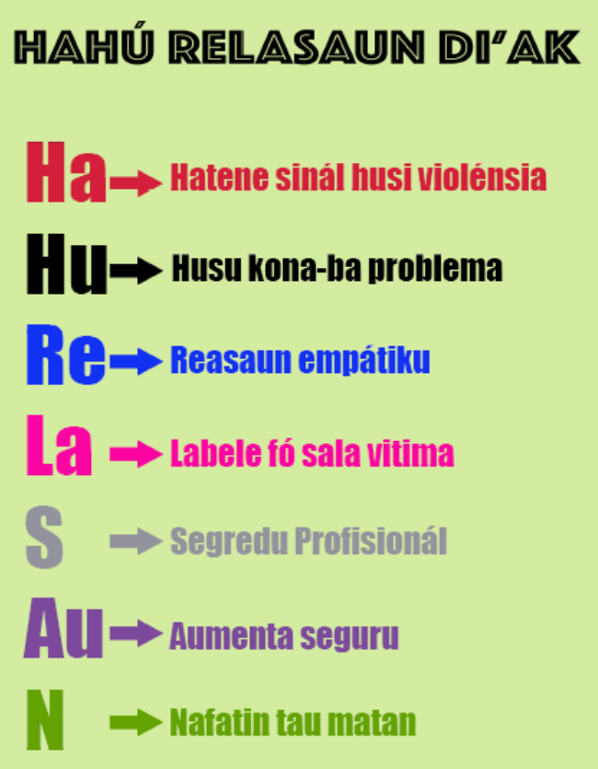
Review Hahu Relasaun di’ak
Notes:
Today we are learning about ongoing support, the final step in responding well, which includes psychosocial support and referral
Read out and explain each of the steps on the slide

Slide 4
Activity: Presentations
Student presentations or guest speaker
Notes:
Purpose: To share findings from students’ visit to referral service and increase their understanding of the services available
Time: 20 minutes (5 minutes for each group to present)
Instructions:
Each group presents the answers to the questions they asked during their visit to referral services (5 minutes each)
They can use PowerPoint, give a brochure or handout, or just speak in front of the class. They should present for 5 minutes each group

Slide 5
Psychological first aid
Victims need emotional support
There are many negative reactions
Do not blame her
Help her identify her support networks
Give her information on how to cope with stress
Notes:
Victims of sexual assault and domestic violence need a lot of emotional support to cope with stress. This is called psychosocial support and is part of psychological first aid.
There are many negative reactions and emotions after being assaulted. Common reactions include anger, fear, anxiety, pain, numbness (trauma response) not being able to sleep or eat, shame, guilt, depression, difficulty resuming normal life
It is very important that you believe the victim and do not blame her for the sexual assault. Blaming women for men’s violence is very common in Timor-Leste, you should tell her and others that’s it’s not the victim’s fault, it is the perpetrator who has done the wrong thing.
Psychosocial support involves helping women identify the social support they have available and giving them information about coping strategies and stress management.

Slide 6
Social support
Support from friends and family is very important
Ask her:
“When you are not feeling well, who do you like to be with?”
“Who do you turn to for advice?”
“Who do you feel most comfortable sharing your problems with?”
Notes:
Good social support from friends and family is one of the most important protections for any woman suffering from violence and stress-related problems. See handout
Ask her:
“When you are not feeling well, who do you like to be with?”
“Who do you turn to for advice?”
“Who do you feel most comfortable sharing your problems with?”
Tell her that even if she does not want to share what has happened with them, she can still connect with family and friends and should participate in activities she enjoys.

Slide 7
Coping Strategies
Build on her strengths and abilities
Continue normal activities
Regular physical activity
Regular sleep schedule
Avoid using alcohol or drugs
Notes:
Encourage her to build on her strengths and abilities. Ask what is going well currently and how she coped with difficult situations in the past
Continue normal activities, especially ones that used to be interesting and pleasurable
Engage in regular physical activity and relaxing activities to reduce anxiety and tension
Keep to a regular sleep schedule and avoid sleeping too much
Avoid using self-prescribed medications, alcohol or illegal drugs
Ask the students to look at the handout on positive coping strategies and connecting with social support. There are also stress reduction exercises we will practice in the final module.

Slide 8
Assess for self-harm
Some women may have severe mental health conditions
These women need special mental health services
Ask how she is feeling
Ask whether she has had thoughts of self-harm
Note if she is agitated, violent, distressed or uncommunicative
If so, she should not be left alone, refer immediately
Notes:
All health providers should know how to provide basic psychosocial/ emotional support and coping strategies but some women may have more advanced mental health conditions, such as severe depression, post-traumatic stress disorder (PTSD) or thoughts of self-harm
These women will need help from mental health specialists, such as counsellors, psychologists and psychiatrists and you should connect her with these services
Ask how she is feeling and what her emotions are. Questions you could ask are:
“How do you feel?”
“Are you having any difficulties coping with daily life?”
“Have you had any thoughts of harming yourself?”
If she has had thoughts of self-harm in the past month or inflicted acts of self-harm in the past year, there is immediate risk of self-harm or suicide
Note if she is now extremely agitated, violent, distressed or uncommunicative. If so there is also immediate risk of self-harm or suicide
If she is showing these signs she should not be left alone. Refer her immediately for emergency mental health support (mental health nurse at some CHCs, mental health worker at the district level, or PRADET counsellors)

Slide 9
Activity: Positive coping strategies
Discussion questions:
What do you do to reduce stress?
Are these activities available to all women in Timor (i.e. in rural areas, young women and older women, women with children or without, women with a disability)?
What examples could you suggest to clients?
Notes:
Purpose: To brainstorm ways in which we are able to reduce our own stress and what strategies we can suggest to clients
Time: 10 minutes
Instructions
Ask students:
What do you do to reduce stress?
Are these activities available to all women in Timor (i.e. in rural areas, young women and older women, women with children or without, women with a disability)?
What examples could you suggest to clients?
Make a list of their suggestions on the board or on butcher’s paper

Slide 10
Identify her needs and provide information
Don’t give her advice
Ask what help she needs
Provide information about services
Support women to connect with other resources
Notes:
When a woman has experienced violence, giving advice is not a good response.
Instead, you should help the woman to identify her problems and what help she wants.
Discuss the woman’s immediate and longer-term needs
E.g. safety, protection, economic, housing, employment, food, social support, drug/alcohol, mental health
Give her information about services that may be able to help with those needs, as well as other sources of help that might be available.
Your goal as a health provider is to support women to connect with other resources for her health, safety, and social support.
Women’s needs generally are beyond what you can provide in the clinic. Your voice is important in encouraging her to seek support.

Slide 11
Connect her with support
It can be difficult for women to contact services themselves
Can you tell me why?
It is best to help her contact the service
Notes:
It can be very difficult for women to get help they need
Can you tell me why you should help a woman call and not just give her the phone number and expect her to call?
o She may not have a phone or credit
o it might not be safe for her to call from elsewhere
o she may not have the courage to do it alone
o she may not remember the information
o it might not be safe for her to take written information with her
It is better to help a woman call the service while she is there, this is called a ‘warm referral’

Slide 12
Warm Referral
Actively help a woman access the service
Explain what the service provides
Explain what will happen when you call
Offer to call for/with her
Notes:
A warm referral means you actively help the women or child to contact the service. Doing a warm referral will reduces barrier to accessing services and increase the chance of the woman or child actually getting help
Explain what the service provides, where it is located and why it can be helpful to the woman’s specific need
Explain what will happen when you call – who will answer (eg duty worker/triage?) and what information they will need to know
Ask if she is ready to make the call
Offer to make a call on her behalf
Offer to make a call together with her
Offer to start the call and then hand to her
Offer a private office space for her to make the call by herself

Slide 13
Follow-up
Make another appointment
See the same health provider
If she does not attend the next appointment make confidential enquiries
Connect with the agency you referred her to
Good documentation is important
Notes:
Make a time for the woman to come back for further treatment or a check-up
Try to ensure she sees the same provider each time
Make enquiries (while preserving confidentiality about violence) if she does not attend the next appointment
Phone the agency you referred her to, to make sure she is ok
Follow up may be more difficult in large CHCs or hospitals – this is when good documentation is even more important

Slide 14
What if she refuses a referral?
Do not pressure her
Inform her of her rights and your responsibility
Do a safety plan
Tell her about services
Offer information on the effects of violence
Make another appointment
Notes:
Do not pressure her, give her time to decide what she wants to do – women in domestic violence situations may need time to think about what to do, and to plan a safe time and way to access services
Inform her of her rights and any responsibilities you may have to report serious crimes, and child abuse, to the police
Do a safety plan
Tell her about services available and how she can access them if she needs
Offer information on the effects of violence on women’s health and children’s health
Make a time for a follow-up visit
If the victim is a child and the family refuses referral contact MSSI OPL, Police VPU or Fatin Hakmatek

Slide 15
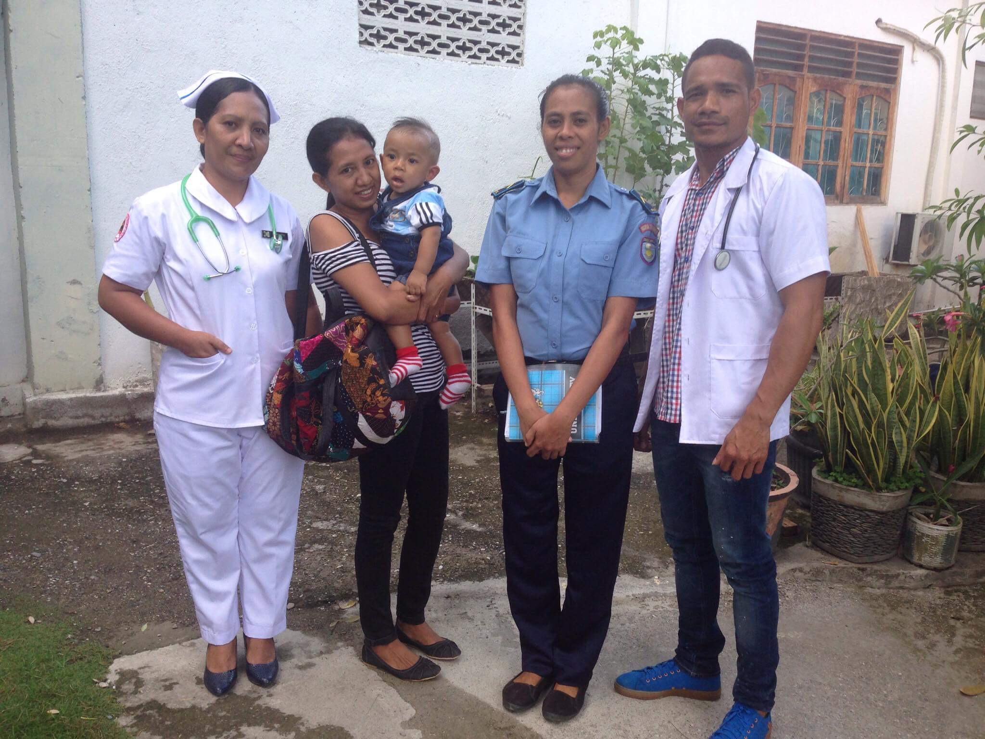
Watch video role play
Watch the role play and think about these questions
What types of problem might Maria need help with?
What organisations does the nurse mention can provide support?
What does the nurse do when Maria is not ready for a referral?
Notes:
Watch the video role play and think about these questions:
What types of problem might Maria need help with?
What organisations does the nurse mention can provide support?
What does the nurse do when Maria is not ready for a referral?
The video can be played directly from the weblink https://youtu.be/D5Pgnsw-xXs.
Play the section from time 17:12 to the end of the video.

Slide 16
Activity: Video role play
What types of problems might Maria need help with?
What organisations does the nurse mention can provide support?
What does the nurse do when Maria is not ready for a referral?
Notes:
Purpose: To understand the complex needs of women experiencing violence and how to do a referral to a diverse range of providers
Time: 15 minutes (5 minutes video, 10 minutes discussion)
Instructions:
Watch scene 4 of the video role play
Discuss the following questions as a group:
What types of problem might Maria need help with?
Immediate safety, legal advice, economic assistance, housing, coping with stress, help for husband’s drinking, follow up medical care and documentation of impact of violence on Maria and children
What organisations does the nurse mention can provide support?
PRADET, ALFeLa, MSS, Alola, Uma Mahon, Policia VPU, Medical Forensic exam/Fatin Hakmatek
What does the nurse do when Maria is not ready for a referral?
Plans for follow up, gives written information, phones trusted sister-in-law, talks to her manager, provides a warm referral

Slide 17
Activity: Warm referral
Break into groups of 3
Decide who is the patient, health provider and observer
The patient reads the case study and explains their situation to the health provider
The health provider listens, offers support, treatment and information about appropriate services
The health provider should offer to make a warm referral based on what the patient wants to do
The observer provides feedback based on Hahu Relasaun, and the list of referral services in the handout
Notes:
Objective: to practice doing a warm referral
Time: 20 minutes (5 minutes to decide on roles and read the case study, 10 minutes to practise, 5 minutes for observer to feedback)
Instructions:
Break into groups of 3 and give each group one scenario
One person is the patient, one is the health provider, one is the observer
The patient reads the case study and explains their situation to the health provider
The health provider listens to the patient, offers support, treatment and information about appropriate services
The health provider should offer to make a warm referral based on what the patient wants to do
The observer provides feedback to the health provider based on Hahu Relasaun, notes from this session about warm referral and follow up, and the list of referral services in the handout

Slide 18
Important messages
Psychological first aid is very important for mental health
Help women identify their support network and give information about coping strategies
Referral starts with identifying a woman’s needs and wishes
Help women contact services they want
Notes:
Psychological first aid is very important for the wellbeing and recovery of victims of violence
Psychosocial support involves helping women identify the social support they have available in their families and communities and giving them information about coping strategies and stress management.
Referring women to professional organisations is also important and should start with identifying a woman’s needs and wishes
You should do a warm referral, which means you actively help the women or child contact the service by phoning them and arranging transport

