Slide 1
Beliefs and attitudes Obstacles for women getting help
Module 2

Slide 2
Module 2: Learning Objectives
Contributors to violence against women and children in Timor-Leste
Common beliefs and attitudes about domestic violence, sexual assault and child abuse
Obstacles for women getting help
Notes:
Week 2: Learning Objectives
Contributors to violence against women and children in Timor-Leste
Common beliefs and attitudes about domestic violence, sexual assault and child abuse
Obstacles for women getting help

Slide 3
Activity: Sex and gender
 | Sex - Biological
Male
Female
 | Gender - Cultural
Masculine
Feminine
Notes:
Purpose: To understand the difference between sex and gender, and that gender roles and stereotypes disempower women
Time: Allow 10 minutes for this activity
Instructions
Explain that sex - being male or female, is different from gender – being masculine or feminine.
Sex is biological, it’s the physical differences between women’s and men’s bodies
Ask the students ‘can you give me some examples of sex differences between males and females?’
Write their answers in the boxes on the PowerPoint, or on the whiteboard (i.e. men: penis, taller, facial hair, deep voice, muscle strength. Women: vagina, breasts, menstruation, pregnancy and giving birth
Explain gender is the social construction of men’s and women’s roles and our culture and families teach us that we should behave in ‘feminine’ or ‘masculine’ ways.
Ask the students ‘now can you give me some words that you think of when you think of ‘feminine’ and ‘masculine’ qualities?’
Write their answers in the boxes on the PowerPoint, or on the whiteboard (i.e. masculine qualities: powerful, aggressive, active, strong, assertive, leader. Feminine qualities: patient, obedient, attractive, caring, maternal).
Ask the students ‘what couldn’t you do when you were little because of your gender?’ (i.e. girls can’t climb trees, play ball games, drive a car, boys can’t cook, play with dolls, wear pink)
Ask the students ‘what is the result of this gender stereotyping for women?’ (i.e. women have less freedom, less money, fewer opportunities, less power).
Because gender roles are created by society, they can and do change over time. As health providers we need to be careful not to reinforce the gender roles that disempower women.

Slide 4
Activity: Gender in our community
If the statement is true, please stand up
Notes:
Purpose: This activity helps students to understand how gender inequality exists in our community
Time: Allow 15 minutes for this activity
Instructions:
Ask all students to sit down. Tell the group that you are going to read a series of statements, If the statement is true, they should stand up.
Ask the students to complete the activity in silence, and to notice how they feel during the activity.
After a statement has been read and people have stood for a few moments, ask everyone to sit down and read the next statement
Statements
Please stand up if:
Your grandfather can read but your grandmother cannot
Your father has access to more land than your mother
Your father went to school for longer than your mother
Boys in your family have more access to school than girls
Boys and men in your family are encouraged to work more than girls and women
You have had more bosses who were men than were women
You have seen or heard of violence against women in your community
You have seen or heard of sexual violence (rape) in your community
You feel unsafe walking around at night time
You have heard men talk badly about women
In your family, women do more of the house cleaning, cooking, childcare and washing than the men do
Reflection:
After the activity, as a large group or ask students to form groups of three and talk about the feelings and thoughts they had during the exercise
Summarise by pointing out that women often have less power in the family, and also in society which makes it less safe for women

Slide 5
The History of Power
In childhood we learned that men are more powerful than women
In childhood we learned that women should obey men
In childhood we learned that men can use their authority over women to teach them using violence
Therefore, many of us tolerate violence against women and remain silent when it happens
Is remaining silent about violence helping or hurting us?
Source: adapted from the Sasa! activist kit
Notes:
In childhood we learned that men are more powerful than women
In childhood we learned that women should obey men
In childhood we learned that men can use their authority over women to teach them using violence
Therefore, many of us tolerate violence against women and remain silent when it happens
Is remaining silent about violence helping or hurting us?

Slide 6
Activity: Meaning of power
Stand in a circle
What do you think of when you hear the word ‘power’
When you catch the ball say one word relating to power
Throw the ball on to another student.
Notes:
Purpose: To explore what power means in our society and how it is perpetuated over generations. Note this activity can be done with or without the ball. If the students are looking tired it is best to do this activity with the ball to energise the group. Or you can just point to each student and ask them to call out a word relating to power.
Time for this activity: 15 minutes
Instructions:
Ask students to stand in a circle
Ask them what they think of when they hear the word ‘power’
Throw a ball to someone and ask them to say one word relating to power, and then have them pass the ball on to another student. Keep throwing the ball until everyone has had a turn.
As the students pass the ball around, write down on butcher’s paper the words that are being said
After everyone has shared their ideas, remind everyone of the words that have been written on the butcher’s paper. Point out the words that were similar and talk about the most common ideas that came up
Reflection:
Lead a discussion with the group by asking these questions:
What do you notice about the people with power? Are they men or women? Educated or uneducated? Older or younger?
Who has the power in your community? Are they men or women? Why is it like this?
Who has the power inside the home? Men or women? Who gave them this power?
Who makes culture? Who continues culture? So who can change culture?

Slide 7
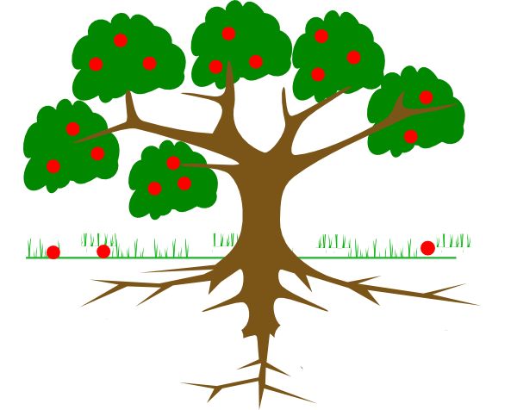
Contributors to violence
Physical violence
Sexual violence
Economic/ controlling behaviors
Emotional/ psychological abuse
Alcohol/drug abuse
Lack of protection
Control over fertility
Lack of access to education
Financial dependence
Normalisation of violence
Marriage – barlake, live with husband’s family, early marriage
Gender roles
Gender inequality
Disrespect for human rights
Abuse of power
Notes:
Violence happens because there is an abuse of power over others
Women and children often have less power because of the way culture and society is structured, which results in gender inequality and disrespect for the human rights of certain people (e.g. women, children, those with a disability)
The underlying causes of violence at the in the roots of the tree should not be confused with individual triggers or excuses for violence (in the middle boxes)
Common excuses for violence include economic problems, lack of communication and trust in a relationship, cheating, using alcohol and/or drugs, speaking up about a man’s bad behaviour
These triggers of violence must never be used as excuses for violence or to clear the perpetrator of responsibility for his actions
When we understand the causes and contributors to violence we can avoid blaming the victim
We can speak out against violence and the abuse of power

Slide 8
Activity: Midwives discuss how gender inequality contributes to violence
“Many women suffer from sexual violence because men consider us women like something very small to them so they do as they wish.”
– 12. Midwives FGD, Baucau
“Recently there was a case, the woman was five months pregnant and she suspect he was cheating. When she asked him he said ‘you don’t have the right to tell me. I married you because you look after our house and our children’ and when she turned her back to him, he took a piece of wood and hit his wife on the back.”
– 2. Midwife, Dili
When we did the promotion about domestic violence many men were not happy. They said ‘it’s culture, It’s because my wife did something wrong I have to teach her.’ And I say, ‘no that’s not culture. Culture is our identity and that’s not our identity. It’s our attitude and we can change it’.
– 7. Domestic Violence Social Worker, Dili
Notes:
Purpose: to see how midwives observe gender inequality and how it contributes to violence
Time: 10 minutes
Instructions:
Tell the students to take 1 or 2 minutes to read the quotes from midwives who participated in the Midwives Against Violence study.
Ask them ‘What are some of the causes of violence that the midwives have identified?’
Some themes to discuss: Sexual exploitation of women, the power of men over women, the normalisation of violence within families, barlaki as an excuse for violence, the gender role of women and their lack of voice, the changes in the Law, how we can change our attitudes to make the world better.
Close the discussion with the following points:
These midwives are all describing how gender inequality, the abuse of power and disrespect for human rights contribute to violence against women in Timor-Leste
Culture and customs should never be used as excuses for violence
Violence is never acceptable, it’s against the law
As health professionals we can challenge these attitudes in our work and in our families

Slide 9
The Truth About Power
Power is the ability to think, feel and do what we decide is right for ourselves
Everyone has a right to their own power
No one should use their power over another person
Using power negatively to control others is an injustice
Using power to harm others is a crime
Source: The Sasa! activist kit
Notes:
Power is the ability to think, feel and do what we decide is right for ourselves
Everyone has a right to their own power
No one should use their power over another person
Using power negatively to control others is an injustice
Using power to harm others is a crime

Slide 10
Activity: Beliefs and attitudes
Read the statement on your piece of paper
Decide whether you agree or disagree
Stick your statement to the board under ‘Yes/True’ or ‘No/False’
Notes:
Purpose: This activity allows us to consider and question common beliefs about domestic violence, sexual assault and child abuse in our community
Time: Allow 15 minutes for this activity
Instructions:
Cut up the handout on beliefs and attitudes and give one or two statements to each participant, give them some blue tack or tape so they can stick their note on the board.
Draw two columns on the whiteboard, one labelled ‘Yes/True’ the other labelled ‘No/False’
Ask the participants to think about the statement written on their paper and decide whether they agree ‘Yes/True’ or disagree ‘No/False’, and the reasons why.
Ask each participant to stand up and give their answer and the reason why they think this.
If the participant gives a ‘No/False’ answer and good explanation, congratulate them and ask them to stick it under the ‘No/False’ column on the board
If anyone answers ‘Yes/True’ or does not give a full explanation, use the answers in the Beliefs and Attitudes Answer Sheet, to explain why the answer is actually No/False.
Ask the participant to stick the paper under the ‘No/False’ column.
At the end of the activity point out that the answers to all of these reasons is ‘No/False’ because violence against women and children is never acceptable.
Tell participants they can read through all the answers in their handout to further understand the reasons why all the answers are false.
Conclude the activity by reminding students that:
Violence is never the victim’s fault.
It is important to understand our own attitudes and biases about gender roles.
As health providers we must provide empathy and information in a non-judgmental way.
We must never let our own attitudes get in the way of providing respectful care.
We must remind ourselves and others that women and children do not ever deserve to be physically, emotionally or sexually abused in any circumstance.

Slide 11
Where do women go for help?
Source: 2016 Nabilan Survey
Notes:
This data is from the Nabilan survey with women in Timor-Leste
It shows that when women experience violence, Most (66%) women do not tell anyone about their husbands’ or boyfriends’ violent behaviour
When they do tell someone, it is mostly friends and family (34%)
Very few women seek help from formal services
Why do you think this is the case?

Slide 12
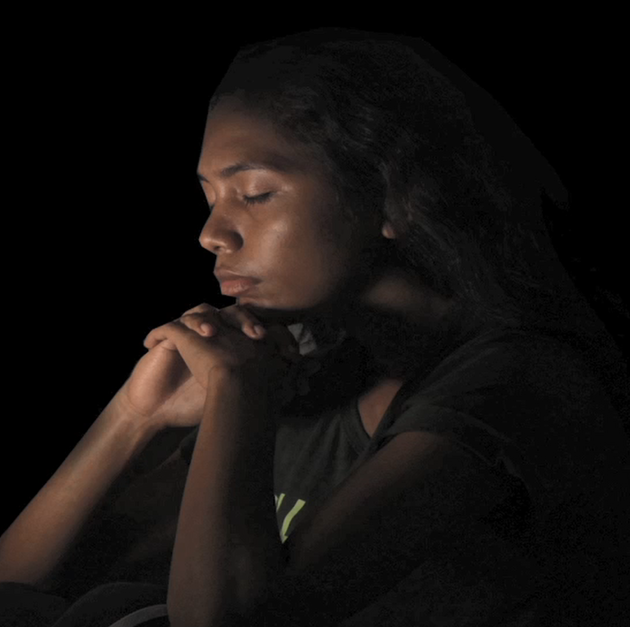
Video: Women’s stories
Watch the video and think about the following questions:
Why is it difficult for these women to get help?
What are the additional challenges for women with a disability?
What can health providers do to help women open up about problems?
https://youtu.be/AALC9kqrho0
Notes:
Explain that these videos are based on the real stories from interviews with 28 women who have experienced domestic and sexual violence in Timor-Leste
Get them to think about the following questions:
Why is it difficult for these women to get help when they are being subjected to violence?
What are the additional challenges for women with a disability?
What can health providers do to help women open up about problems they are being subjected to?
Warn students that the stories can be quite emotional for some people and that it’s ok to leave the room if they don’t want to watch it or it becomes too overwhelming
The full video can be played directly from the internet on this link https://youtu.be/AALC9kqrho0

Slide 13
Activity: Obstacles for women getting help
Discuss the following questions:
Why is it difficult for these women to get help when they are being subjected to violence?
What are the additional challenges for women with a disability?
What can health providers do to help women open up about problems they are being subjected to?
Notes:
Purpose: to understand more about the effects of violence and trauma, what stops women from getting help, and what encourages them to open up their problems and find support.
Time: 20 minutes (10 minutes video, 10 minutes discussion)
Instructions:
After the video ask the students the following questions and write their answers on the board:
Why is it difficult for these women to get help when they are being subjected to violence?
Shy/embarrassed
Lack of confidentiality if family work at the health centre or other people see them there
Shameful and uncomfortable when other people look at them and know they are a victim of violence
Live in the mountains, or have no money or transport to get to a health facility
Threatened or forbidden by the abuser to go out, worried it will make him angrier
He is violent at night and there is no transport or services open
Have a small baby or sick child so cannot leave the house
What are the additional challenges for women with a disability?
Dependent on others for their care
Can’t physically get there without assistance
May not know what abuse is or be able to speak about it
More isolated with less social support
What can health providers do to help women open up about problems they are being subjected to?
Don’t be angry
Smile, speak kindly and ‘from your heart’
Attend to them quickly
Provide a private, secure and calm place to do the consultation
Ask about violence, more than once (if you do not ask, women feel they cannot tell you)
Tell her it’s not her fault

Slide 14
Important messages
Because of culture, men have more power than women
Violence is an abuse of power
We must examine our own attitudes to avoid blaming the victim
Women face many barriers getting help
We must speak out against violence
Complete reading - Mane ho feto kompletu malu
Notes:
Because of the way men and women’s gender roles are constructed in our culture, men have more power than women. This is called gender inequality.
Violence happens when there is an abuse of power, and those with the least power are most affected.
As health providers we have a responsibility to examine our own beliefs and attitudes so that we don’t blame victims for the violence they are subjected to.
The women’s stories in the videos showed the trauma they experience and the challenges they face in finding safety.
Because of the many barriers to getting help, we must speak out against violence and help women to feel safe discussing their problems.
The next part of the course will give you the tools and skills to be able to respond effectively to women and children subjected to violence.
Please complete the reading for module 2 at home – “Mane ho feto kompletu malu” (found in your list of readings). As you are reading think more about how can make sure we do not reinforce gender inequality or disempower women when we are providing care.

