Slide 1
Health provider responsibilities Laws and policies
Module 3

Slide 2
Module 3: Learning Objectives
Role and responsibility of healthcare providers within a health system response to violence against women and children
Laws and policies for responding to violence against women and children in Timor-Leste
Notes:
At the end of this session students should be able to demonstrate knowledge of the:
Role and responsibility of healthcare Providers within a health system response to violence against women and children
Laws and policies for responding to domestic violence in Timor-Leste

Slide 3
What is the role of healthcare professionals?
Responding to violence is part of the law, and important for health
Provider role:
Provide first-line response, care, safety and referral for all survivors
Providers are NOT responsible for:
‘Resolving’ violence
Determining legal aspects
Notes:
Responding to survivors of abuse and violence is part of the law, and it is important for health
Investigating the underlying cause of a patient’s injury is part of good medical care
Provider role:
provide first-line response with empathy, medical care, safety and referral for all victims of violence
Providers are NOT responsible for:
You are not responsible for ‘resolving’ their case, for example, you should not speak to the woman and the perpetrator together
You are not responsible for determining the legal aspects of the violence or assault, for example, you should NEVER ask the family or the perpetrator if the story is true.

Slide 4
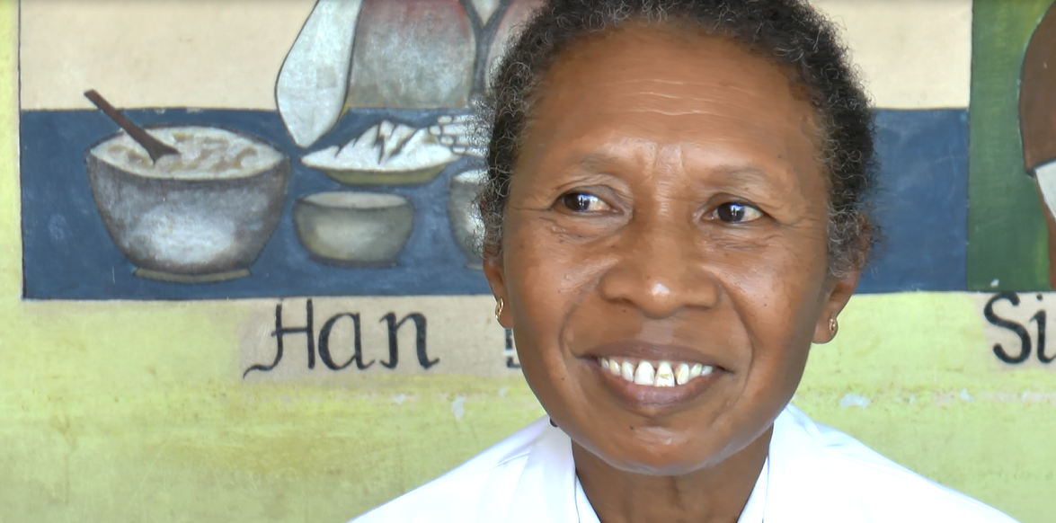
Video: Midwives against violence
Watch the video, think about these questions:
a. What do you think the Law Against Domestic Violence means?
b. Why did the midwives feel it was their responsibility to help women?
c. What are the important aspects of care midwives said they need to provide?
Weblink: https://www.youtube.com/watch?time_continue=9&v=vw5nN0eePcY
Notes:
Watch the video that includes interviews with midwives, but it is also applicable to doctors, nurses and other people working in the health sector in Timor-Leste
The video can be played directly from the internet via this Weblink: https://www.youtube.com/watch?time_continue=9&v=vw5nN0eePcY
Get students to think about the following questions:
Were you aware that there is a Law Against Domestic Violence in Timor-Leste? What do you think this Law means?
Why did the midwives feel it was their responsibility to help women who were victims of violence?
What were the important aspects of care that the midwives said they needed to provide for victims?

Slide 5
Activity: Video discussion questions
Discuss the following questions:
Were you aware there is a Law Against Domestic Violence in Timor-Leste? What do you think this Law means?
Why did the midwives feel it was their responsibility to help the women?
What were the important aspects of care the midwives needed to provide?
Notes:
Purpose: To listen to midwives talk about the Law Against Domestic Violence, why it’s their responsibility to help victims of violence, and what aspects of care are important.
Time: 15 minutes (10 minutes video, 5 minutes discussion)
Instructions:
Discuss the questions below:
Were you aware that there is a Law Against Domestic Violence in Timor-Leste? What do you think this Law means? (i.e. that domestic violence is a crime, it is not appropriate for families to use violence, all people in Timor-Leste have rights, health providers have a responsibility to help women and children who are subjected to violence)
Why did the midwives feel it was their responsibility to help women who were victims of violence? (i.e. the health effects of violence for the woman, the impact on the baby, to reduce maternal and infant mortality, to reduce trauma, it’s difficult for women to speak about their problems, they don’t know where to go and don’t have transport so health providers must help them)
What were the important aspects of care that the midwives said they needed to provide for victims? (i.e. attend them quickly, provide medical treatment, have a private place, build trust to help them speak out, keep their information confidential, create a calm and safe place for them, encourage them and provide information to get further help).

Slide 6
Healthcare professionals are important for first-line support
Attend to immediate emotional/psychological needs
Provide treatment
Support safety
Information and referral
Help women feel more in control and provide ongoing support
Notes:
They can attend to the immediate emotional/psychological needs of the woman
Provide treatment and address physical health issues
Support ongoing safety needs
Provide information and refer to other organisations and resources
Help women feel more in control and provide ongoing support, especially mental health needs

Slide 7
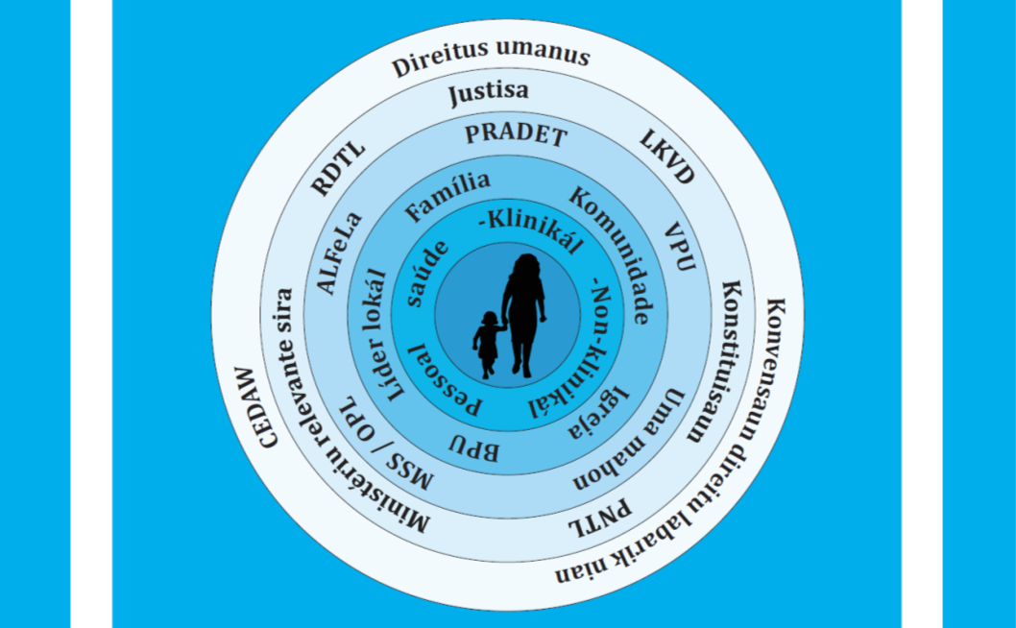
Who is responsible?
Notes:
Everyone in our society has responsibility to protect women and children from violence - from the health care professional, from the family and community from the non-government organisations like PRADET and the Fatin Hakmateks and Uma Mahon, the police and the church to the wider role played by traditional leaders, government departments and the health care system.
They are supported by Timor-Leste’s constitution and international laws related to human and women and children’s rights that Timor-Leste has signed and committed to implement.
So the health care professional is not alone in helping victims of violence, and have many other organisations in the community and government to help them in their duty of care.

Slide 8
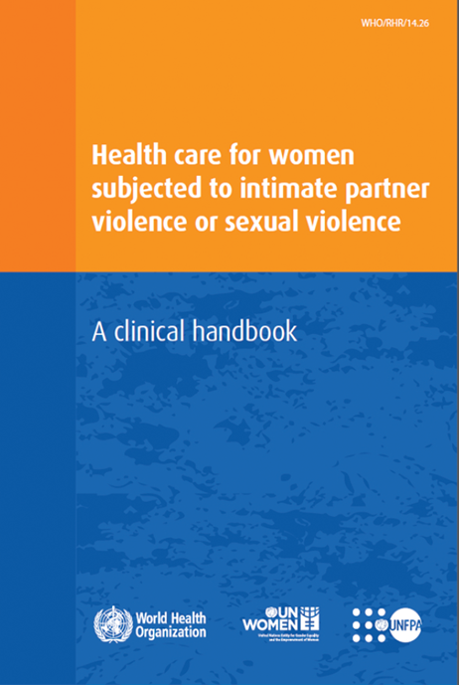
Policy context in Timor-Leste
Notes:
Timor Leste’s government have signed many policies committing to improving the lives of women and children. Some of them are:
Convention on the Elimination of Discrimination Against Women (CEDAW – ratified in 2002)
Convention on the Rights of the Child (2002
Law Against Domestic Violence (2010)
National Action Plan on Gender-based Violence (2012 & 2017)
They have also developed guidelines for Timor’s health professionals, many based on the WHO Clinical Handbook (2013)
The Medical Forensic Protocol (2004)
Draft National Guidelines for Health Sector Response to Gender-based Violence in Timor-Leste (2017)
This curriculum (2018)
These are to guide and help the work of health professionals responding to the needs of their clients experiencing violence and abuse

Slide 9
The Law in Timor-Leste
The Penal Code
Spouse abuse and child abuse are illegal
The Law Against Domestic Violence
Domestic violence is a public crime
Legal obligation to prosecute cases and provide assistance to victims
Age of consent is 14
People under the age of 14 do not have the capacity to give consent
It is illegal to participate in sexual activity with anyone younger than 14 years, or an inexperienced person under 16.
Age of marriage is 17
It is illegal to marry someone younger than 17 years
Notes:
Law no. 17/2009 - The Penal Code
Criminalizes spouse abuse (Article 154) and child abuse (Article 155)
Law no. 7/2010 - The Law Against Domestic Violence (LADV)
Recognises domestic violence as a public crime under the Timor-Leste constitution
Provides a legal framework to prosecute cases, prevent domestic violence and provide assistance to victims
Article 22 (assistance in hospital services) and Article 40 (professional secrecy) are directly relevant to health care providers (see handout)
Age of consent is 14
People aged 14 and older are able to consent to medical procedures, including decisions to have contraception
Children under 14 do not have the capacity to give consent to sexual activity or to medical procedures
It is illegal to participate in sexual activity with anyone younger than 14 years
Engaging in sexual activity with an adolescent between 14-16 can also be a crime, if the adult took advantage of his/her inexperience.
A person over the age of 16 is not allowed to participate in any sexual activity with a person under 14 years old, even if the person under 14 wants to
Children under the age of 16 do not have criminal responsibility
Age of marriage is 17
Only people aged 17 or over are legally able to marry. People who are 16 are able to marry with their parent’s permission. Marrying someone under the age of 16 is against the law.
Point to the handout which outlines the Laws that criminalise domestic violence in Timor-Leste

Slide 10
Important messages
The way health providers respond is important for survivor’s wellbeing
Be aware of the laws and policies for responding to violence against women and children
Prepare questions for guest speaker
Notes:
Health providers have an important role in providing care, treatment and referral to additional support services.
Remember – responding effectively to violence can generate important healing for survivors.
All health providers should be aware of the laws and policies in Timor-Leste that protect the rights of victims and outline the responsibility of health providers under the law
Ask the students to think about and write down any questions they have for the guest speaker

Slide 11
Activity: Guest speaker
Laws and policies on responding to violence against women and children
Responsibility of health providers
Notes:
Purpose: To enhance students’ understanding of the laws and policies around responding to violence against women and children in Timor-Leste
Time: 45 minutes (30 minutes to present, 15 minutes for questions)
Instructions:
Invite a Ministry official (i.e. SEM, MSS, Ministry of Health, Ministry of Justice) or other individual knowledgeable about national, subnational and institutional policy (i.e. ALFeLa, JSMP, TAF’s Nabilan Program) to present on the local policy environment, including any challenging areas or areas of conflicting policy.
Ensure the focus remains on health care and what the policy environment means for health care providers.
They could address topics such as:
What is the Law Against Domestic Violence and what does it mean for health providers?
Under what circumstances is reporting mandatory under the law?
What is the legal age of marriage and consent, and the obligation of health providers to help child victims?
A specific example of a case, what worked well and what were the challenges in collaborating with health providers?

