Slide 1
Effects on health and Identifying signs of violence (Ha)
Module 4

Slide 2
Module 4: Learning Objectives
At the end of this session students should be able to demonstrate an understanding of the:
Short and long-term physical and psychological consequences of domestic violence
Physical and behaviour signs of violence in adults
Physical and behaviour signs of violence in children
Notes:
At the end of this session students should be able to demonstrate an understanding of the:
Short and long-term physical and psychological consequences of domestic violence
Physical and behaviour signs of violence in adults
Physical and behaviour signs of violence in children

Slide 3
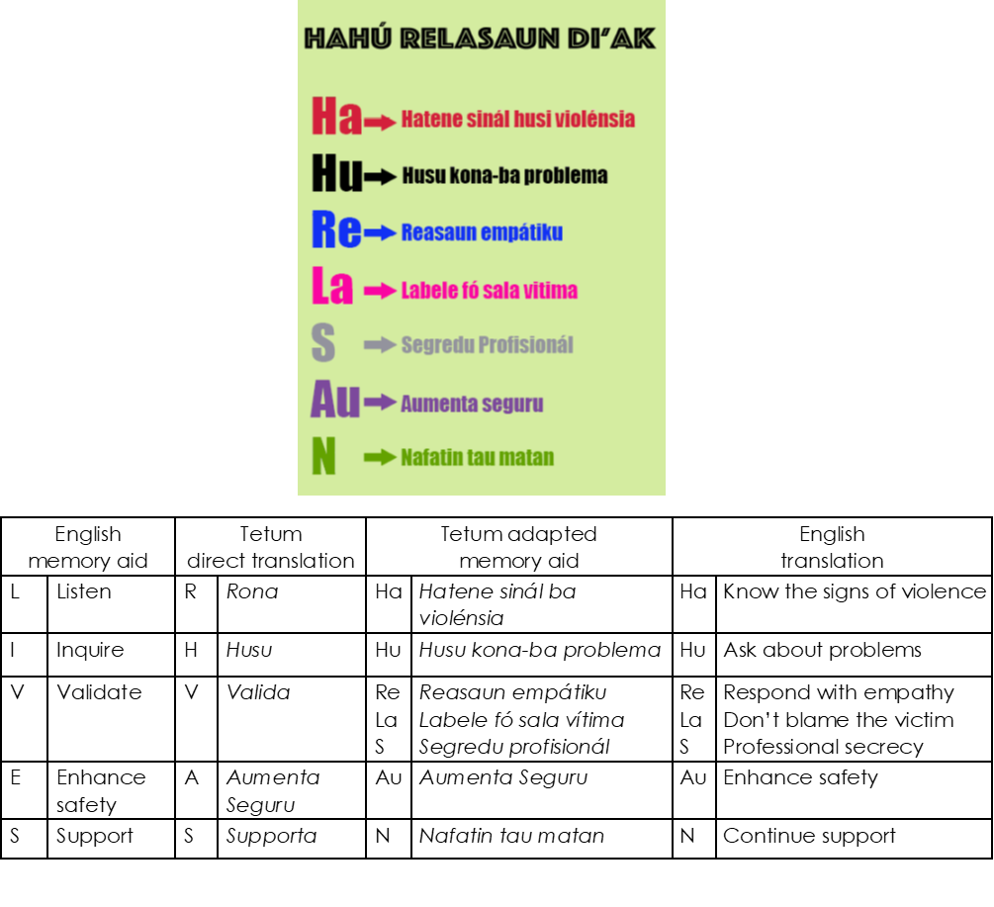
HaHu ReLaSAuN di’ak
Notes:
A job aid to help you remember good responses to women experiencing violence
It is based on a similar job aid created by the World Health Organisation – LIVES in English, but has been adapted to make sense in Tetum
Today we are going to learn about the Ha step – knowing the signs of violence by understanding more about the impact on women and children

Slide 4
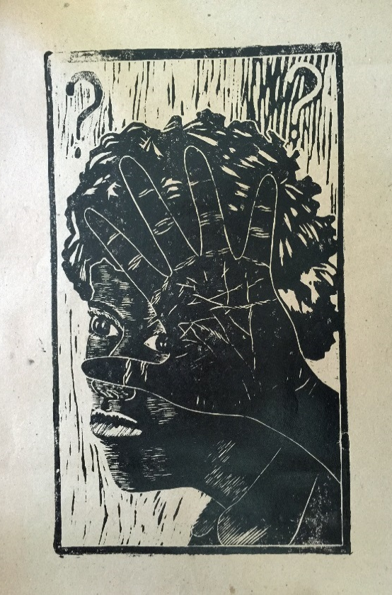
Effects of domestic violence
Unplanned pregnancy
Alcohol and drug use
Stress and Depression
Low birthweight
Murder
Attempted suicide
HIV
Miscarriage
Injury
Sexually transmitted infections
Disability
Source: Gembel Art Collective
Notes:
This picture includes some, but not all of the most common impacts of domestic violence. These outcomes have been reported from women in countries all around the world, not just in Timor.
Women who are experiencing sexual assault or unwanted sexual experiences often cannot use contraception and therefore have more unwanted pregnancies. They also have more sexually transmitted infections, (including HIV), more miscarriages, low birthweight and premature babies and stillbirths.
If they are experiencing this and other forms of violence, they experience a lot of stress, certainly depression, many forms of injury - and they may be murdered by their husbands or partners.
All of this can be compounded by what we experienced and witnessed during the war, and the ongoing trauma many people have from that.
Women can also take to self-medicating with alcohol and other forms of drugs, including tobacco. This can also affect the health of their babies. All the stress and depression can make it hard for women to care for their children effectively.

Slide 5
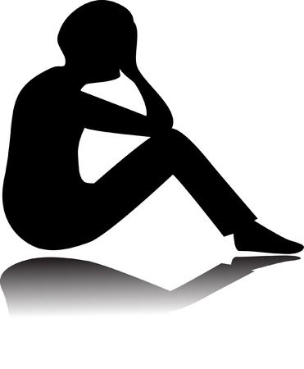
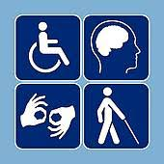
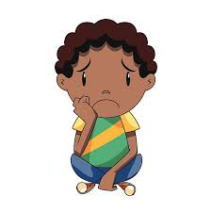
Health impacts of partner violence
Mental health
2 x more depression
5 x more thoughts of suicide
8 x more attempted suicide
Disability
2 x more risk of disability
Reproductive health
3 x more STIs
2 x more unplanned pregnancy
Less contraception
Less antenatal care
Child health
3 x more emotional and behavioural problems
1.5 x more likely to die
Less vaccination
Notes:
Finding from the 2010 Demographic Health Survey and the 2016 Nabilan study found many health impacts of violence for women and children in Timor-Leste:
Mental health – women who had experienced violence in their lifetime were 2 x more likely to have experienced depression, 5 x times more likely to have had thought about committing suicide and 8 x more likely to have attempted suicide, compared with women who had never experienced violence.
Disability – women who had experienced violence in their lifetime were 2 x more likely to have a disability
Reproductive health – women who had experienced violence in their lifetime were 3.5 x more likely to have an STI, 2 x more likely to have an unintended pregnancy and had fewer antenatal visits. They are also more likely to have had a partner stop them using contraception, and less likely to share decision-making about birth-spacing.
Child health – children of women who had experienced violence had fewer vaccinations, and were 2 x more likely to have emotional and behavioral problems such as nightmares, wetting the bed, being timid, being aggressive or dropping out of school. They were 1.5 x more likely to have had a child who has died.

Slide 6
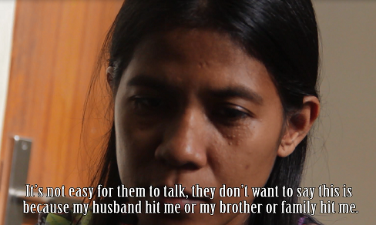
Video: Women talk about trauma
Watch the video and think about the impacts of domestic violence:
the physical, emotional and socio-economic impacts on women and children
the short-term and long-term impacts
Notes:
Explain that these videos are based on the real stories from interviews with 28 women who have experienced domestic and sexual violence in Timor-Leste
When they are watching the video ask students to think about the impacts of domestic violence, to pay attention to:
the physical, emotional and socio-economic impacts on women and children
the short-term and long-term impacts
Warn students that the stories can be quite emotional for some people and that it’s ok to leave the room if they don’t want to watch it or it becomes too overwhelming

Slide 7
Activity: impact on health and wellbeing
Q. What do you think are the impacts of violence on women and their children?
Think about the physical, emotional, and socio-economic impacts on women and children
Think about the short-term and long term impacts
Notes:
Purpose: To understand the broader impact of violence and trauma on women’s health and wellbeing
Time: 15 minutes total - watch video (5 minutes), discussion in pairs (5 minutes), feedback to group (5 minutes)
Instructions:
Watch the video, which is based on interviews with women who have been subjected to violence.
Get into groups of two
Discuss and write down the impacts of domestic violence, pay attention to:
the physical, emotional and socio-economic impacts on women and children
the short-term and long-term impacts
Ask each group to share their list and reasons with the class
Effects to discuss with the class
Atina: Injury/unconscious, not able to eat, resentment/sadness, death.
Maia: STI, abandonment, no food, mental health, children sick.
Joana: unintended pregnancy, fear, isolation, baby died.

Slide 8
HATENE (Know the signs of violence)
Physical signs and symptoms of violence in women
Behavioral signs and symptoms of violence in women
Signs and symptoms of violence in children
Signs and symptoms of sexual abuse in children
Notes:
Physical signs and symptoms of violence in women
Behavioral signs and symptoms of violence in women
Signs and symptoms of violence in children
Signs and symptoms of sexual abuse in children
Note also that many women and children who are experiencing violence at home will not have obvious signs or symptoms

Slide 9
Physical signs and symptoms of violence
Chronic headaches or pain
Abdominal pain
STIs
Unwanted pregnancy, repeat abortion
Injuries during pregnancy
Injuries - multiple injuries or pattern of repeated injury
Source: Signs of violence adapted from PACTS Study Guide
Notes:
Chronic headaches or aches and pains
Abdominal pain
Sexually transmitted infection or sexual dysfunction
Unwanted pregnancy, repeat miscarriages or abortion
Injuries during pregnancy
Injuries – like bruising, head injury, front teeth missing, hair pulled out, ears or fingers removed, fractures, cuts, stab wounds, burns, bites, ruptured eardrums, injuries to the face, neck, chest, breast, genitals
Multiple injuries or pattern of repeated injury

Slide 10
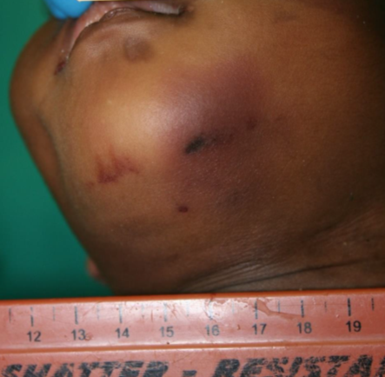
Typical injuries
Source: PRADET MFE training manual
Bruises
Source: Teaching collection, Forensic Pathology Unit, Royal Darwin Hospital, Australia
Notes:
These pictures show patterns of bruising on different parts of the body as a result of injuries from violence

Slide 11
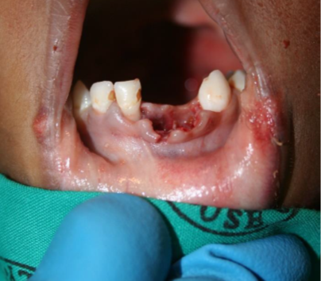
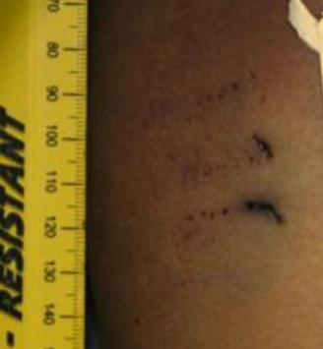
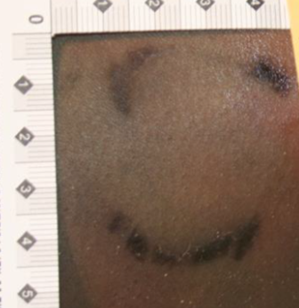
Typical injuries
Missing teeth
Fingernail scratches
Human bite mark
Source: Teaching collection, Forensic Pathology Unit, Royal Darwin Hospital, Australia
Notes:
These pictures show some of the other types of physical injuries you might see that are a result of violence, including missing teeth, bite marks and fingernail scratches.

Slide 12
Behavioural signs and symptoms of violence
Nervous, evasive
Anxiety, very stressed
Mental health problems
Attempted suicide
Describes husband as angry
Alcohol, smoking or drug problem
Sleeping or eating problems
Notes:
Appears nervous, ashamed, evasive
Suffers anxiety, panic attacks or very stressed
Mental health problems, depression
Attempted suicide
Describes their partner as controlling or prone to anger
She or her partner have an alcohol, smoking or drug problem
Sleeping or eating problems

Slide 13
Behavioural signs and symptoms of violence
Husband or family do most of the talking
Anxious when her husband is there
Story about injuries does not match physical exam
Delay in seeking care
Notes:
Comes to the clinic with her partner or family and they do most of the talking
Appears uncomfortable or anxious when her husband is there
Her story about the injuries changes or does not match the physical examination
Delay in seeking medical attention or reluctant to follow advice

Slide 14
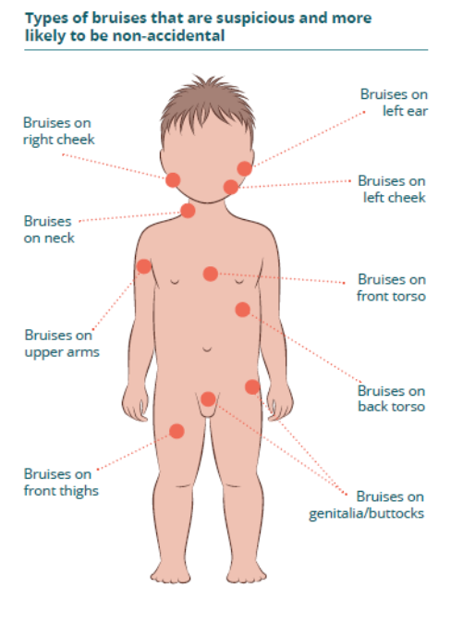
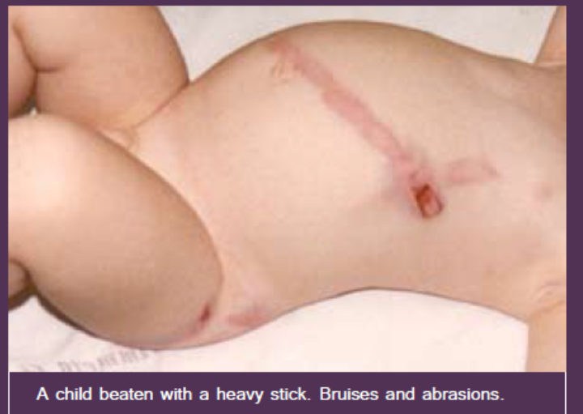
Physical signs and symptoms of violence in children
Injuries
Fractured bones
Poisoning
Source: PRADET MFE and 4R training manual
Notes:
Injuries - bruises, burns, sprains, dislocations, bites, cuts, internal injuries
Fractured bones – especially in an infant where a fracture is unlikely to have occurred accidentally
Poisoning

Slide 15
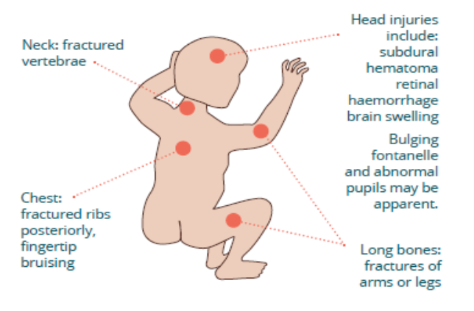

Shaken baby syndrome
Notes:
A baby has a weak neck and heavy head, when a baby is shaken it makes the fragile brain bounce back and forth inside the skull
Shaking causes bruising, swelling and bleeding inside the head, which can lead to brain damage or death
Injuries to watch out for include bleeding on the brain, bleeding in the eyes, damage to the spinal cord and neck, and fractures of the ribs and bones
Symptoms to watch out for include irritability, lethargy, poor feeding, breathing problems

Slide 16
Behavioural signs and symptoms of violence in children
Distrust of adults
Fear of parents
Fearful when other children cry or shout
Excessively friendly to strangers
Withdrawn, passive, tearful
Low self-esteem
Delayed speech
Acting like a much younger child
Wearing long-sleeved clothing to hide injuries
Notes:
Distrust of adults
Fear of parents and fear of going home
Being anxious, becoming fearful when other children cry or shout
Excessively friendly to strangers
Withdrawn, passive, compliant and/or tearful
Low self-esteem
Delayed speech
Acting like a much younger child (for example, soiling or wetting pants)
Wearing long-sleeved clothing to cover bruises or other injuries

Slide 17
Signs and symptoms of sexual abuse in children
Telling someone sexual abuse has happened
Headaches or stomach pains
STI
Pregnancy
Problems with schoolwork
Sexual behaviour or knowledge unusual for the child’s age
Non-typical behaviour i.e. rocking, sucking, biting
Difficulties sleeping
Difficulties relating to adults and peers
Notes:
Telling someone sexual abuse has occurred (children hardly ever make up stories about this)
Headaches or stomach pains
Sexually transmitted infection
Pregnancy
Problems with schoolwork
Sexual behaviour or knowledge unusual for the child’s age
Non-typical behaviour such as frequent rocking, sucking and biting;
Difficulties sleeping
Difficulties relating to adults and peers

Slide 18
Activity: Identifying sign of violence
Read the two stories that the midwives told in the Midwives Against Violence study
What signs did the women have that might mean they were being subjected to violence or abuse?
Share your list with the larger group
Notes:
Purpose: to identify some of the common signs and symptoms women present with
Time: 20 minutes (10 minutes to read the quotes and take notes, 10 minutes for discussion)
Instructions:
Read the two stories that the midwives told in the Midwives Against Violence study
Think about and make notes on the signs the women had that might mean they were being subjected to violence or abuse?
Share your list and reasons with the larger group
Sum up:
Many women who go to the health centre with injuries may be experiencing violence at home
But not all women who are being abused will have visible injuries
There are also common psychological symptoms that we need to look out for

Slide 19
Important messages
Many short and long-term health impacts of violence
Watch for physical and behavioural signs
Notes:
There are many short and long-term health impacts from violence, not just from injuries but from the ongoing stress and trauma women and children are exposed to.
Health providers can identify signs of violence by staying attentive to physical and behavioural cues, particularly for women, children and other vulnerable people.

