Slide 1
Building rapport Asking about problems (Hu)
Module 6

Slide 2
Module 6: Learning Objectives
Obstacles for healthcare providers asking about violence
The importance of rapport and trust in facilitating good communication
How to raise the subject and know how to ask about suspected abuse

Slide 3
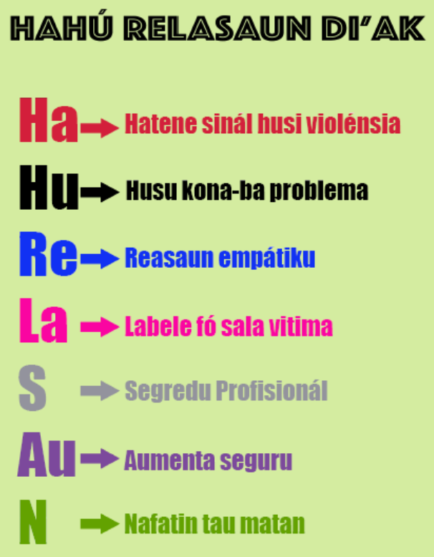
Review HaHu ReLaSAuN di’ak
Notes:
In module 4 we learned about Ha – Knowing the signs of violence
Today we will be learning about Hu – Asking about problems
Review the steps in Hahu Relasaun diak

Slide 4
Activity: Obstacles for healthcare professionals
Do you have any concerns about being able to ask women or children about violence?
Notes:
Purpose: To discuss any obstacles or concerns the students have in being able to respond to ask women or children about violence
Time: 10 minutes
Instructions:
Ask the students “Do you have any concerns about being able to ask women about violence?”
Discuss how each of their concerns can be overcome with good training and support
Some examples to help you answer their concerns are:
Afraid for their own safety – you will be learning about important safety strategies for yourself as well as clients during this course. Your manager and the police have an important role in protecting safety in the clinic and the community.
They don’t want to support the victim because they are related to the suspect – health providers have a professional duty of care. If there is a conflict of interest they should organize care by an alternative provider.
There is not enough time - Assessing and responding to abuse can potentially be a life-saving process and can be done efficiently. Because violence affects health, understanding experiences of violence can provide important insight into patient health and may reveal the underlying cause of the presenting issue.
Fear of offending the client - Women who have been affected by violence are often waiting for an opportunity to speak about some aspect of what they are going through. Evidence shows that women do not mind being asked about abuse when done sensitively and without judgement, and that they appreciate provider expression of care. Your patient may actually trust you more by knowing that you care about her health and safety
The woman is with family or there is nowhere private to talk – think of creative ways to ensure privacy. See if there is a room that is not currently being used, make an excuse to see the patient on their own
Colleagues and other staff are unsupportive – seek support from other services in the area
Don’t know how to help - Speaking with clients about violence provides important support and can be the first step in her realizing help is available. These discussions become easier with training, time, and practice.
4. Reassure them that this course will give them the knowledge, skills and resources to feel able to help women and children in very difficult circumstances. It will also help them to know how to care for themselves and their colleagues.

Slide 5
HUSU (ASK about problems)
Remember non-verbal communication and privacy
Build rapport
Raise the subject
Ask the right types of questions
Notes:
If a health provider notices any of the physical or behavioural signs or symptoms of violence we learned about in Module 4, it is important to ask the patient more about the problems they are facing
This can be very difficult for women to talk about and also for health providers to feel comfortable asking about, but it gets easier the more you practise
There are certain ways of asking and certain things that need to be in place which will help women to open up about violence
Remember to pay attention to your non-verbal communication and only ask a woman about problems when she is on her own
Today we will be learning about the next steps:
Building ‘rapport’ or trust
Raising the subject
Asking the right types of question

Slide 6
Build Rapport
Build rapport
Introduce yourself, make ‘small talk’, avoid direct questions initially
Listen to what she is saying and help her feel connected
Build trust
Especially important with children
Notes:
Rapport means establishing a good relationship where people have a connection, understand each other’s feelings and communicate well
Introduce yourself, make ‘small talk’, avoid direct questions initially
Ask students what they might say to open a conversation? Some examples are:
“What brings you here today?”
“What would you like to talk about?”
“What are your main concerns?”
Listen to what she is saying and help her feel connected
Build trust - people find it easier to talk to those they trust
Building rapport and trust is also important when dealing with children as they may be afraid and they often find it difficult to talk.
Some ideas are giving them a ball, playing a game with them, give them something to eat or drink
Take your time - you need more time to build rapport with children

Slide 7
Raise the subject
Raise the subject
“Many women experience problems with their husband or someone else they live with”
“When I see injuries like this I wonder if someone could have hurt you.”
Ask open questions
“How is your relationship with your husband/ boyfriend?”
“What happens when he gets angry”
“Do you have any worries you want to talk about?”
Notes:
Once you are in a private place and have spent some time building rapport, you can start to raise the subject of problems she might be having
Raise the subject – simple statements can let women know they are not alone and may help them open up about their own experiences. For example:
“Many women experience problems with their husband or someone else they live with”
“When I see injuries like this I wonder if someone could have hurt you.”
Ask open questions to get a conversation started. They encourage the woman or child to answer in their own way. For example:
“How is your relationship with your husband/ boyfriend?”
“What happens when he gets angry?”
“Do you have any worries you want to talk about?”

Slide 8
Specific questions
Ask specific questions
“Are you afraid of your husband (or partner)?”
“Does your husband try to control you, for example not letting you have money or go out of the house?”
“Did someone force you to have sex?”
“Have you spoken to anyone about this?”
Avoid very general or leading questions
Notes:
After you have raised the subject and she has disclosed the abuse you can ask more specific questions
Specific questions are direct questions that ask for a yes/no answer
They are useful for gaining detailed information required for medical treatment, taking a history, and finding out how safe her and her children are. For example:
“Are you afraid of your husband (or partner)?”
“Does your husband try to control you, for example not letting you have money or go out of the house?”
“Did someone force you to have sex?”
“Have you spoken to anyone about this?”
When asking about violence, ask about specific acts like “did someone bite you?” or “has your partner ever threatened you with a weapon?”
Don’t ask “are you a victim of domestic violence?” because the woman may not see herself as a victim or understand the term domestic violence
Don’t ask leading questions, which are questions that direct her into giving a certain answer. For example, don’t say “what happened to your eye, did you walk into the door?”

Slide 9
What if a woman does not disclose violence?
Do not pressure her
Believe her
Give her more time
Tell her about services
Offer information on the health effects of violence/stress
Offer referral options and a follow-up visit
If it’s a child consult with relevant services
Notes:
Do not pressure her, give her time to decide what she wants to tell you
Remember to believe her. She may not actually be a victim
Give her more time to stay, sit with her and chat
Tell her about services available if her situation changes or someone she knows needs them
Offer information on the effects of violence on women’s health and children’s health
Offer her referrals to support and a follow-up visit
If the client is a child and you suspect abuse consult with MSS OPL (Child protection officers), Police Vulnerable Person’s Unit, Casa Vida, or Fatin Hakmatek

Slide 10
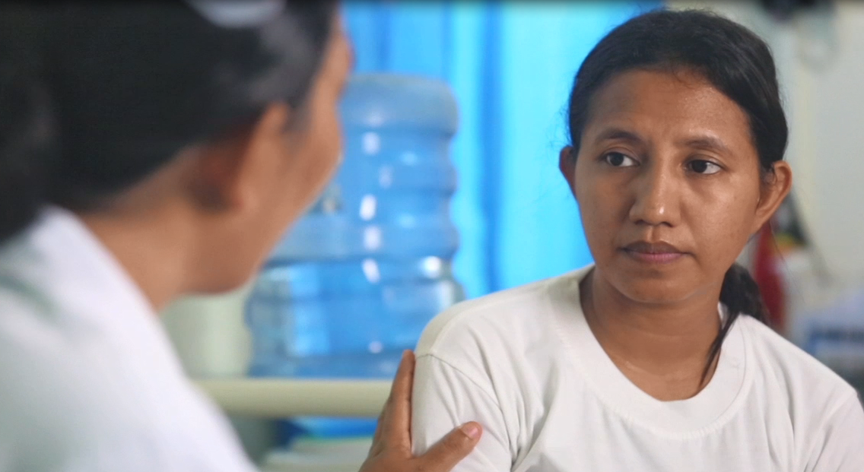
Watch video role play
Watch the video and to notice how the nurse:
ensures privacy
her non-verbal communication
what questions she asks
Notes:
Play the video and ask students to note how the nurse ensures privacy, her non-verbal communication and what questions she asks
The video can be played directly from the weblink https://youtu.be/D5Pgnsw-xXs.
Play the section from the beginning to time 4:54.

Slide 11
Activity: Discuss video role play
Discussion questions:
Why did the nurse suspect Maria’s injury was not an accident?
What strategies did the nurse use to ensure privacy?
What open-ended questions did the nurse use to ask about violence?
How did the nurse demonstrate good non-verbal communication?
What good practices did the nurse demonstrate when Maria did not disclose violence?
Notes:
Purpose: To observe how a health provider ensures privacy and asks sensitively about suspected abuse
Time: 15 minutes (5 minutes to watch the video, 10 minutes for discussion)
Instructions:
Lead a discussion by asking the following questions
Answers to discussion question:
Why did the nurse suspect Maria’s injury was not an accident?
type of injury, Maria’s demeanour, story changes, story doesn’t match injury, Maria is worried about getting home
What strategies did the nurse use to ensure privacy?
took Maria to a private room, asked sister-in-law to wait, spoke to the chefe in a private room, did not reveal the name of the patient
What types of questions did the nurse ask?
Open questions such as “sometimes cuts like this can be from someone hurting you, has that happened to you?”, “Do you have any other health problems, any problems at home?”
How did the nurse demonstrate good non-verbal communication?
waited until after the stitches to ask about violence, sat next to Maria before asking, placed her hand on her shoulder when offering support
What good practices did the nurse demonstrate when Maria did not disclose violence?
Didn’t pressure Maria to talk about it, got contact details and arranged follow-up visit, mentioned services that are available and offered to contact them, reassured Maria that she is always ready to help her

Slide 12
Activity: Role play asking about violence
Break into groups of 3
Decide who will be the patient, the health provider, the observer
The patient reads the scenario to themselves, the others read the handout on ‘asking about violence’
The patient tells the symptoms and the health provider gives the appropriate care and asks the relevant questions
The observer looks at the handout and provides feedback on the health provider’s approach
Notes:
Purpose: to practice asking about violence in a clinical scenario
Time: 40 minutes (10 minutes to read the scenario and get into character, 25 minutes to practice, 5 minutes for the observer to give feedback)
Instruction:
Ask students to break off into groups of three (this can also be done with two ‘actors’ presenting to the group)
One student is the patient, one is a health provider and one is an observer
Give each patient a scenario and ask them to read it first without sharing it with the group
While the patient is reading the scenario, the health provider and observer should read the handout on asking about problems
Begin the role play. The patient reads only the symptoms to the health provider
The health provider gives the appropriate care and asks the relevant questions about violence if they think it is happening
The observer’s role is to look at the handout ‘asking about violence’ and provide feedback to the health worker on their approach to asking about violence
The facilitator should also walk around and give feedback where possible
If there is time, each student can swap roles and have a turn being the patient, health provider and observer using the three different scenarios.

Slide 13
Important messages
Build trust
Start by raising the subject and asking open questions
Ask specific questions to find out more
If she does not disclose – provide information, build trust, follow up
Keep practising the skills you learned
Notes:
It can be difficult to ask a client about their problems, but it is an important part of health care
You should be friendly and build trust with all your clients, especially if they have suffered trauma
Start a conversation by raising the subject of violence generally and asking very open questions
Once she feels comfortable to open up you can ask more specific questions to find out more about her needs
Remember that health providers have an important role even if she does not disclose abuse – we can still provide information, build trust through good communication and plan for follow up
Getting comfortable with asking about violence can take time. Your skills will continue to improve the more you practise. Use your handouts to keep practicing good ways of asking.

