Slide 1
Responding with empathy (Re)
Doing no harm (La)
Protecting confidentiality (S)
Module 7

Slide 2
Module 7: Learning Objectives
At the end of this session students should be able to demonstrate knowledge of:
How to listen and communicate empathically with clients
How to do no harm and avoid re-traumatising victims of violence
How to protect a client’s confidentiality and explain it’s limits
Notes:
At the end of this session students should be able to demonstrate knowledge of:
How to listen and communicate empathically with clients
How to do no harm and avoid re-traumatising victims of violence
How to protect a client’s confidentiality and explain it’s limits

Slide 3
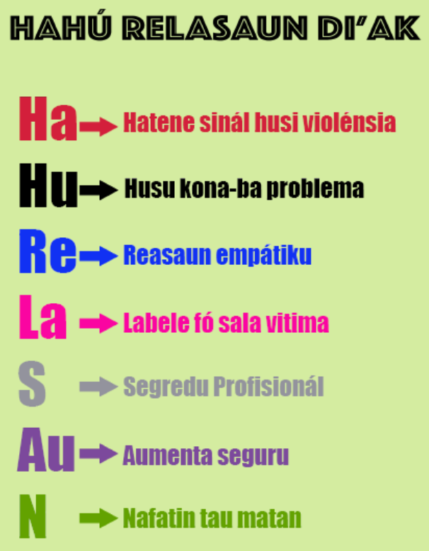
Review of HaHu ReLaSAuN di’ak
Notes:
Today we will be learning the middle three steps of Hahu Relasaun
Read out and explain each of the steps on the slide

Slide 4
Respond with empathy
Empathy shapes people’s experience of care
Showing empathy is one of the most important things you can do for survivors of violence
Empathy means:
  Understand the situation from her perspective
  Check your understanding and reinforce her value
  Act of the information in a way that is helpful
Notes:
Showing empathy and compassion will shape a patient’s experience of health care
Research has shown that when health providers show empathy, patients are more satisfied with their care, experience less distress and have better health outcomes
For victims of violence and complex trauma, responding with empathy is one of the most important things a health provider can do.
There are three key aspects to empathy:
Understand a person’s situation and feelings from their perspective (imagine you are them)
Check your understanding of what she is saying and reinforce her value
Act on the information in a way that is helpful.

Slide 5
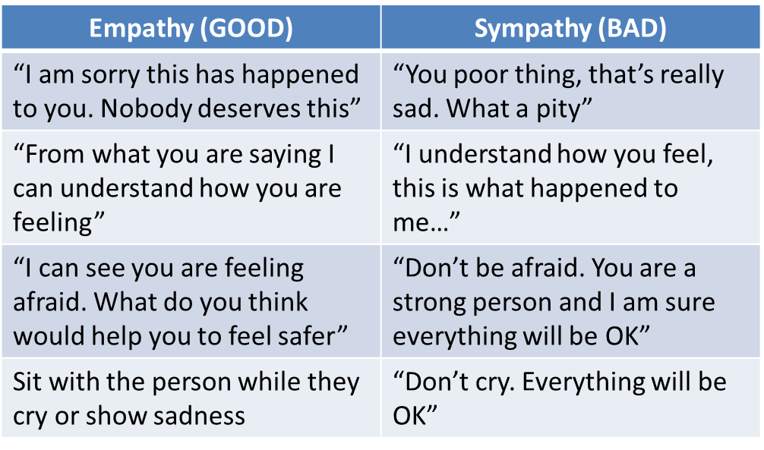
Empathy
Notes:
Empathy is different from sympathy
Sympathy is feeling sorrow or pity for the hardships that another person experiences
Whereas empathy is understanding her thoughts and feelings, making her feel valued, and has action as the outcome
Get the students to read the following sentences to themselves – point out that the responses under ‘sympathy’ are not very empowering and tend to dismiss the woman’s feelings.

Slide 6
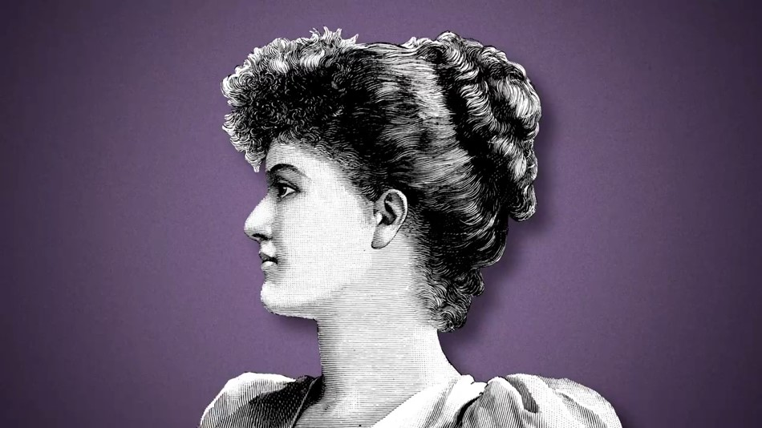
Video on meaning of empathy
Notes:
Watch this animation about the difference between empathy and sympathy, from an American researcher Brené Brown
The video can also be played directly from the weblink(in English) https://youtu.be/1Evwgu369Jw

Slide 7
Active listening
Listen with your eyes, ears, and heart
Give her time
Learn what is most important to her
Understand her point of view
Pay attention to her verbal and non-verbal communication
Notes:
An important part of responding with empathy is listening carefully to what a woman is saying
Active listening means listening with your:
Eyes - give her your undivided attention
Ears - truly hear her concerns
Heart – be caring and respectful
Give the woman time, give her a chance to share her experiences in a safe and private place – this is important for emotional recovery
Active listening allows you to learn what is most important for the woman so that you are able to help address her needs
Active listening allows you to understand the situation from the woman’s point of view
Active listening involves paying attention to the woman’s verbal and non-verbal communication – her posture, facial expression, tone and speed of speech, her words and meaning behind the words, and what is not said

Slide 8
Active listening
Acknowledge her feelings - “that must have been very frightening”
Encourage her to keep talking - “and then what happened?”
Allow for silence - “it’s ok, take your time”
Let her cry and express her feelings - “are you ok to continue?”
Help her express her needs - “how can we help?”
Summarise and respect her wishes - “What I am hearing you say is…”
Notes:
Acknowledge and reflect back how she is feeling – for example - “That must have been very frightening”, “it sounds like you are feeling very angry”
Encourage her to keep talking, stay focussed on her experience – “Would you like to tell me more about…?”, “and then what happened?”
Allow for silence, give her time to think and tell her story at her own pace – “it’s ok, take your time”
If she starts to cry it’s ok, give her time and offer her a tissue. If she is angry let her express her feelings. Never end the interview or ask her to leave. When she is ready ask “are you ok to continue?”
Help her identify and express her needs – “what do you think is the best thing to do?”, “how can we help?”
Summarise what she expressed and respect her wishes - “What I am hearing you say is…”

Slide 9
Activity: Active Listening
Break into groups of 2
Think about a challenging situation you have been in recently, or it might be a situation and tell their partner about it
One person is the listener who will demonstrate active listening and empathy first, then they swap
Notes:
Purpose: to practice active listening and identify elements of listening well
Time: 15 minutes (5 minutes for each person to tell their story, 5 minutes for group discussion)
Instructions:
Break into groups of 2
Ask students to think about a challenging situation they have been in recently, or it might be a situation where they have felt victimised in the past (nothing too heavy), and tell their partner about it
One person is the listener who will demonstrate active listening and empathy first, then they swap
When they have finished ask them to discuss the following questions:
How did it feel talking about it?
What did the listener do physically to show that they were listening attentively to you?
What did the listener do verbally (i.e. through what they said) to show that they were listening attentively to you?
What responses made you feel more likely to tell more?
How did you feel afterwards?

Slide 10
DON’T BLAME THE VICTIM
DO NO HARM
Victim blaming is holding the person responsible for the harm that happened to them
Examples of victim-blaming questions
Remember the offender has committed the crime
Notes:
It is important that health providers DO NO HARM and avoid further traumatising the victim
Victim blaming happens when the victim of a crime of wrongful act is held responsible or at fault for the harm that happened to them
AVOID asking victim-blaming questions, never say things like – “why did he hit you?”, “why don’t you just leave him?”, “did you have an argument before the violence happened?”, “why did you go there alone, don’t you know it’s dangerous?”
Never tell her to go home and not provoke her husband because this puts the blame on her rather than holding the perpetrator responsible
Remember it’s not her fault, it is the offender who has committed the crime

Slide 11
Other things to avoid
Do not tell her what she should do
Do not try to solve her problems
Minimise distraction and interruptions
Do not force her to describe frightening details
Do not persuade her to leave or stay
Do not bring your own attitudes or judgements
Do not react with shock or pity
Never insist that children answer questions
Notes:
Do not tell her what she should do based on your own opinion or values. Your role is to give her information and let her make her own decisions.
Do not try to solve her problems – let her make her own decisions
Minimise distraction and interruptions – wait until she has finished before asking questions. For example do not look at your watch, rush her, answer the phone or write while she is talking
Do not force her to describe painful or frightening details because it can re-traumatise her
Do not persuade her to leave or stay in a violent relationship. Violent relationships are often dangerous for the children, you should never convince a woman to stay in a violent relationship because of the children.
Do not bring your own attitudes or judgements – i.e. it is not the providers’ role to disapprove if she is pregnant or not married
Do not react with shock or pity, don’t tell her how she should feel. For example don’t say “you should not feel so sad, you should feel lucky you survived”
It is especially important not to insist a child or adolescent answer questions when they don’t want to, as it may cause further trauma or compromise their safety
Ask the students ‘does anyone know why we don’t do these things?’ (principles to discuss: woman-centred care, she makes her own decisions, do no harm, minimising trauma, not putting her safety at risk)

Slide 12
Reinforce her value
“Your life and your health are important”
“No one deserves to be hit or feel scared at home”
“Everyone deserves to be safe”
“I am concerned about the effect on your health”
“It’s not your fault”
Especially important when responding to children
Notes:
Instead of victim blaming, let her know violence is wrong
Let her know she has a right to live without violence. Tell her “Your life and your health are important”
Tell her “No one deserves to be hurt or feel scared at home”
Tell her “Everybody deserves to be safe”
Let her know about the possible effects of violence on her health and that you care about her wellbeing. Tell her “I am worried about the effect on your health”
Tell her “It’s not your fault”, “You are not to blame”
An empathic and non-judgemental response is particularly important when speaking with children and adolescents. You should reassure them that they are not to blame for the abuse and they have done the right things by telling someone.

Slide 13
Further considerations when responding to children
Evolving capacity of the child
Provide information that is age-appropriate
Seek informed consent
Respect the ability of children to make decisions
Offer choices
Notes:
Evolving capacity of the child or adolescent – the ability of children to understand and make choices evolves with their age and developmental stage.
Provide information that is age-appropriate – tailor information, your choice of words and use of visual aids (like drawing or dolls) to the child’s age and their ability to understand information. For example the way you would explain an STI test to a 14 year old would be different to explaining it to a 4yo.
Seek informed consent – this means you provide information about what is happening, why it’s being done, you check they understand and you get their consent. Informed consent is required for clinical care and all decisions and actions to be taken. The legal age of consent for medical interventions in Timor-Leste is 14 years. If the child is 13 or younger, consent from a non-offending care given should be obtained.
Respect the ability of children to make decisions for themselves – respect their wishes, for example not forcing them to give information or be examined. This needs to be balanced with the need to protect their best interest and safety. In cases where their wishes cannot be prioritised, the reasons should be carefully explained before further steps are taken.
Offer choices – give the child choices in the course of medical care, such as who is present in the room, the next steps to be taken, and how they provide information (i.e. by writing, drawing or showing with models)
Can anyone give me any other examples of things we need to consider when talking with children?

Slide 14
Activity: Good responses
Break into pairs
Read the quotes from midwives in the handout
After you read each quote, discuss these questions:
  Is this considered good practice or not? Why?
  How could the midwives have responded better?
Notes:
Purpose: to think about the elements of good responses to women who have been subjected to violence.
Time: 15 minutes (10 minutes to read the quotes, 5 minutes to discuss answers)
Instructions:
Break into pairs (or this can be done as larger group with the whole class)
Read the quotes from the handout which were said by midwives interviewed in the 2016 Parteira Kontra Violensia study
After you read each quote is, discuss these questions as a pair:
Is this considered good practice or not? Why?
How could the midwives have responded better?
4. Afterwards get groups to feed back one or two of their responses to the class
5. For the bad responses (a, b, d, e, g) read out what a better response would be from your answer sheet in the handouts.
Give counselling to the mother to change her behaviour...many times we don’t blame only the husband. Sometime we ask the wife why did your husband hit you? If she said something that made her husband feel not good we remind her not to repeat again – 25. Midwife, Liquica
Answer: This is a bad response, it is blaming the woman for her husband’s violent behaviour. This is called victim blaming. A better response would be “there is never an acceptable reason for a husband to hit his wife, we can give you information about where to get help”.
b. I also help them through advising them how to be a mother. We say to them ‘you must be patient because this is our way to be a mother’…If you don’t want to get domestic violence, when your husband comes back from work leave him to relax, breath fresh air then tell your problem to him. Some women, their husband just arrives home, they don’t even take off their shoes or change their clothes and straight away she tells the problems to him – 16. Midwife, Baucau
Answer: This is a bad response, this is victim blaming and advising a woman what to do. It reinforces inequitable gender roles and the myth that women should be patient and men should be aggressive. Men can communicate without violence, and talking about problems together is never an excuse for violence. A better response would be “I can see you are feeling afraid, what do you think would help you to be safer?”
c. The counsellors don’t force women to go back to their husbands, but to strengthen what they feel so they can take decisions for their lives. To build their capacity to have confidence, this is really important – 23. Domestic Violence Social Worker
Answer: This is a good response. Many woman who have been abused lack confidence, it is good to build their confidence and encourage them to make their own decisions.
d. So before they go to the court to sign, our help is we tell them to forgive each other because children need a father. So our help is to encourage with words, how a family that wants to separate can accept each other to live together. – 12. Midwives FGD, Baucau
Answer: This is a bad response and very dangerous to say this. Men who beat women are not good fathers. Research shows that violence often gets worse over time and the children are often beaten as well. It takes a lot of courage for women to get help and especially to leave a violent partner. A health provider should never give advice like this or tell a woman what they should do. A better response would be “you are very brave, thank you for sharing your story. Would you like to talk about ways to enhance your safety during this difficult time?”
e. We help with the counselling, give information that as husband and wife we sit together, talk to each other to solve the problem. We don’t need other people to know, moreover if the case is known by the police it will make shame for the husband and wife. If there is a problem between husband and wife sit together and solve it. – 25. Midwives FGD, Liquica
Answer: This is a bad response. There are many special services designed to help with these problems and this response discourages women from getting the help they need. Because men have more power in the family, it is not likely that women will be treated fairly if it resolved in the family. Being violent is a decision that men make and they should be held accountable. We must speak out about violence and health providers have a responsibility to work with women to report it to the police. There is no shame in accessing support. A better response would be “It sounds like you are having a lot of problems at home. I can give you information on where you can get more help with that”
f. The important one is we have to make them relax, because actually before they come they faced high stress, sad and crying. Therefore when she goes back she will feel that support which we gave, it will add to her thinking and minimize stress, worry and sadness. – 5. Midwife, Dili
Answer: This is a good response. The midwife recognises the trauma and stress the woman went through and helped her to feel calm and supported. Research has shown that providing moral support is very important to improve women’s mental health and recovery.
g. The patient who comes with a case of violence, we consider them a normal patient…we don’t give other support except treatment for her wounds. – 2. Midwife, Dili
Answer: This is a bad response because the midwife only focusses on medical treatment. Victims of violence need extra care because of the trauma they experienced, they need to be treated kindly and be in a private place. Even when the case is already with the police, health providers have an important role in providing moral support, and checking to see if her and her children are safe from further harm. A better response would be “You might feel uncomfortable waiting with the other patients, would you like to wait in this room that’s not being used? I will get you some water and a blanket”
h. Generally, victims who come to us, we always care for them. First of all, we have to secure them; second, treat them if there is any injury or any pain in their body; third, give them information; fourth, if she wants to process her case we provide medical forensic examination; fifth, we will refer her to a place if she doesn’t want to stay in her house, we have to give her a place through our partners like Fokupers, Casa Vida. After the treatment, if there is any disease or any more injury as a result of the violence, we must ask her to come again to continue her treatment within one week. If after one week she doesn’t come, we must call her by phone and go to her place. – 5. Midwife, Dili
Answer: This is a comprehensive response from a midwife. It shows the steps we should follow when caring for victims of violence, and how we should focus on respecting her decisions while ensuring she gets access to good healthcare.

Slide 15
Legal requirement to maintain confidentiality
Especially important for children’s safety
Keep health information private
Only ask or talk about violence when she is alone, in a private room
Don’t share her story or information with others
Never try and verify the accuracy of the information
Keep records in a secure place
Gain her permission to provide information or give a referral
Explain to her what confidentiality means and it’s limit
Notes:
Ask the students ‘can anyone tell me what confidentiality means?’
Under the Law in Timor-Leste, providers are required to maintain confidentiality of information which they become aware of because of their professional relationship with the victim in their care
Protecting the privacy of children and being careful with the collection and handling of their information is particularly important for ensuing children’s safety
Confidentiality means keeping a patient’s health information, story and documents private
It means only asking or talking about the violence in a private room, when the woman is on her own and where nobody can overhear
Confidentiality means not sharing this information with her partner or family, not talking about it with your friends or colleagues who are not directly involved in her care.
It is very important that you don’t try and verify or check the accuracy of her story by asking her husband, her family or anyone else. This will break confidentiality and will put her in danger. A health provider’s job is to listen and believe her, help document her story and her injuries, and support her to find further help.
Confidentiality means you have to keep the victims’ records in a secure place (i.e. locked filing cabinet, password protected file on a computer)
It means gaining the victims’ permission to provide information or give a referral to appropriate areas (advocacy service, legal, police, etc)
Health providers should explain to the woman what confidentiality means, that they will keep her information private, and circumstances in which they can’t be confidential (discussed below)

Slide 16
Limits to confidentiality
Always explain the limits to confidentiality
Responsibility to document and report crimes
If called to testify in court
Need to give information to staff directly involved in her care
The victim’s wishes and safety should always be prioritised when sharing information
Before sharing information, always discuss with the victim how and when this will happen
Notes:
There are certain limits to confidentiality and these should ALWAYS be explained to survivors up front
Under Timor-Leste’s Law Against Domestic Violence, if health providers become aware of domestic violence, sexual assault or child abuse they have a responsibility to document the facts and report crimes to the police or competent authorities. This is particularly important if the victim is a child or the health provider believes the woman’s life is at risk
Health providers may also be called upon to testify if the case is brought to court, or provide other information to law enforcement agencies
Health providers may share information with other staff directly involved in the victim’s care
The victim’s wishes and safety should always be prioritised when discussing when and how to share information (i.e. if the perpetrator is a police officer, if a staff member is related to the victim or perpetrator)
If there is an obligation to report a crime or share information the provider should discuss with the victim how and when this will happen
Ask the students ‘why do you think it is important to explain the limits of confidentiality to women?’ (i.e. it’s part of women-centred care and giving women good information, it’s important for safety – remember the perpetrator is most likely to harm her when she is getting help).

Slide 17
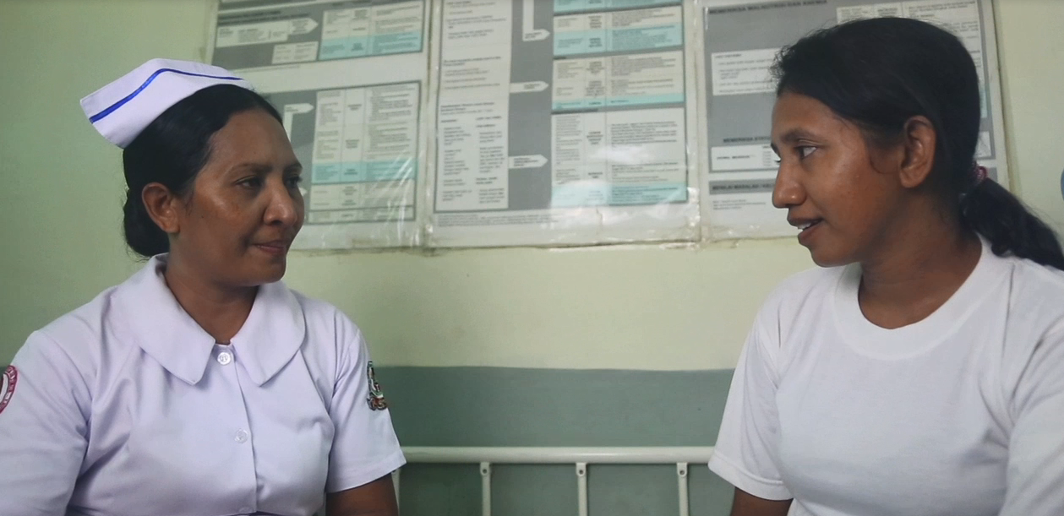
Watch video role play
Watch the video and think about these questions:
How did the nurse deal with confidentiality?
How did the nurse demonstrate active listening and empathy?
Notes:
Watch the video and think about these questions:
How did the nurse deal with confidentiality?
How did the nurse demonstrate active listening and empathy?
The video can be played directly from the weblink https://youtu.be/D5Pgnsw-xXs.
Play the section from time 4:54-9:04.

Slide 18
Activity: Video role play
Q. Discussion questions:
  How did the nurse deal with confidentiality?
  How did the nurse demonstrate active listening and empathy?
  How else could you respond?
Notes:
Purpose: To observe a how a health provider ensures a woman’s confidentiality, and how she demonstrates active listening and empathy
Time: 15 minutes (5 minutes video, 10 minutes discussion)
Instructions:
Watch the first part of Scene 4
Lead a discussion on the following questions:
How did the nurse deal with confidentiality?
Ensures nobody can overhear. Tells Maria she is not going to tell people in the community but she has an obligation to report crimes like domestic violence to the police
How did the nurse demonstrate active listening and empathy?
Allows for silence, let’s Maria tell her story in her own time. Sits with Maria and does not interrupt when she begins to cry
Probes for information, encourages her to keep talking “How long has this been going on?”
Reflects back how she is feeling “That sounds very frightening”, “That must be very stressful for all of you”
Avoids victim blaming “No-one should be pushed around and alcohol is certainly no excuse. Men can drink and not hurt those they are supposed to care for.”, “You know that violencia domestika is a crime in Timor-Leste, so what your husband is doing is very wrong.”
Reinforces her value “You know, you deserve better than this. “everybody deserves to feel safe at home.”

Slide 19
Activity: Responding with empathy
Break into groups of 2
Read your scenario to yourself first
Take turns being the health provider and patient
Give each other feedback about how the health providers’ response made you feel
Notes:
Objective: This role play allows students to practice empathic responses
Time: 20 minutes (5 minutes to read the case study, 5 minutes for each person to act as the health provider, 5 minutes for feedback)
Instructions:
Ask the students to break into groups of 2
Each group gets 2 scenarios (1 each) and they should read the entire scenario to themselves
The students should take turns being the health provider and patient
The patient reads items 1 and 2 to their health provider
The health provider’s job is to ask questions and provide support, using ideas and statements from the Hahu Relasaun handout
The patient’s role is to describe why they are there or what symptoms they are seeking care for and respond to the questions asked by health worker
After each person has had a go at being the health provider and the patient they should talk about how the health providers’ responses made them feel and give each other constructive feedback
The facilitator should walk around the room and observe the interactions, manage the time and give feedback to the pairs as well as the larger group

Slide 20
Important messages
Responding with empathy is one of the most important things you can do
Never blame the victim
You are required to maintain confidentiality
Obligation to help children
Practise conveying empathy, confidentiality and reinforcing her value in your own words
Notes:
Responding with empathy is one of the most important things you can do. It involves understanding her situation, making her feel valued and taking action in a helpful way.
Violence survivors are so often silenced by perpetrators, family members and others in the community. Listening carefully makes survivors feel heard, and represents a step towards healing.
You should never blame the victim for what happened to her, remember it is the perpetrator who has committed the crime.
As a health provider, you are required to keep a client’s information confidential and to clearly explain any responsibilities you have to share their information with others. Remember, maintaining confidentiality is very important for women and children’s safety.
Helping children who have been abused can be challenging, but we have a particular responsibility to ensure their safety because often they won’t be able to access any other help.
Make a photocopy of the handout on Hahu Relasaun communication, put it on your wall and practise the statements often. Think about how you can convey empathy, confidentiality and the client’s value in your own words.

